Slide 1
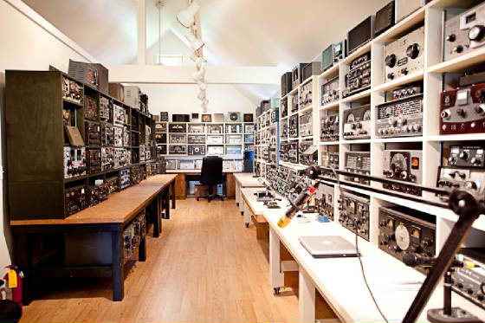
General Class License
Element 3
A little more of a good thing.
Chapter 1, 2, and 3 ARRL General Class License Manuel

Slide 2
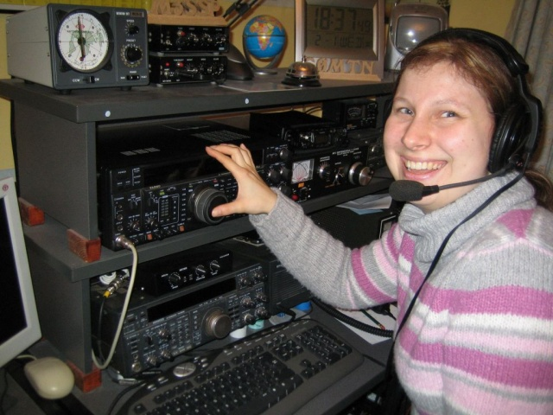
Why Upgrade

Slide 3
www.wednettraining.com

Slide 4
www.wednettraining.com

Slide 5
Technician Class
General Class.
A little different
Primarily operate in the
VHF UHF spectrum
Operate in the VHF UHF
and HF spectrum
Radios are usually handheld and mobile
Desk Top base station radios are often added
Channelized frequencies
Continuous tunable frequencies within the bands
Use of repeaters
Local to DX operation G2A11
Generally FM
Generally SSB, most common used voice mode G2A05 CW and digital
ARES RACES and EMCOMM
Emergency communications over many hundreds of miles
Radio to Radio communications, limited distance
Radio to Radio communications, un-limited distance

Slide 6
Technician Class
General Class.
Propagation generally line of sight
Propagation, ground wave, sky wave, NVIS
Excellent local, and public service communications
Short contacts to “Rag Chews”
Local Nets
Wide area Nets
A few contesting opportunities
Many contests and awards
Call letters announced to initiate a contact
CQ called to initiate contact
200 Watts on HF max
1500 Watts on HF Max

Slide 7
Technician Class
General Class.
Gain greater knowledge and increase skills
And it’s fun

Slide 8
Where does amateur radio live in the frequency spectrum
>>Wavelength Decreases >>>>Antennas Elements Shorten>>>>Loses increase>>>Communications become line of sight>>>>
Exception USB
 | MF |  |  | HF |  |  | VHF |  |  | UHF
300 KHz |  |  | 3 MHz |  |  | 30 MHz |  |  | 300 MHz
 |  |  | 3.5 MHz | 80 Meters | 4 MHz
 |  |  | 5.33 MHz | 60 Meters | 5.4035 MHz |  | CHP |  | 420 MHz | 70 cm | 450 Mhz
 |  |  |  |  |  |  |  |  |  | FRS/GMRS
 |  |  | 7 MHz | 40 Meters | 7.3 MHz | 50 MHz | 6 Meters | 54 MHz
 |  |  | Lower sideband
 |  |  | Upper sideband
 |  |  | 10.1 MHz | 30 Meters | 10.150 MHz
 | AM |  |  |  |  |  | TV
 |  |  |  |  |  | 88 | FM
 | Broadcast |  |  |  |  |  | Broadcast | 108 | 902 MHz | 33 cm | 928 MHz
 |  |  |  |  |  |  | TV
 |  |  |  |  |  |  | Aviation
 |  |  |  |  |  |  | Aviation |  |  | Cell Phone
 |  |  | 14 MHz | 20 Meters | 14.350 MHz |  | Military |  | 1240 MHZ | 23 cm | 1300 MHz
 |  |  |  |  |  | 144 MHz | 2 Meters | 148 MHz
 |  |  |  |  |  |  | Municipal
1.8 MHz | 160 Meters | 2 MHz
 |  |  |  | 17 Meters
 |  |  |  | 15 Meters
 |  |  |  |  |  | 219 MHz | 1.25 Meters | 225 MHz
 |  |  |  | 12 Meters
 |  |  |  | CB
 |  |  | 28 MHz | 10 Meters | 29.7 MHz
3 MHz |  |  | 30 MHz |  |  | 300 MHz |  |  | 3000MHz
Primary a night time band. |  |  | Primary General and Extra Class privileges |  |  | Technician class home range |  |  | Technician class home range
Very short daytime range |  |  | Limited Technician privileges |  | SSB on 10 M | 6 meters the un-predictable band |  |  | Line of sight communications
 |  |  | CW on 40 and 15 meters |  |  | Line of sight communications |  |  | Suited for repeater operation
 |  |  | Long distance communications |  |  | Suited for repeater operation |  |  | 70 cm suited for mobile and portable
 |  |  | Large antennas. |  |  | FM and digital modes.
 |  |  | Day to night from upper to lower freq. |  |  | Suited for mobile and portable comm.
 |  |  | 60 and 30 meter special restrictions |  |  | 2 mtr SSB and CW at lower band edge
 |  |  | Solar activity critical |  |  | Satellite and EME |  |  | Satellite and EME
Wavelength = 300/ Freq. (MHz) |  |  | Frequency (MHz) = 300/ Wavelength (mtrs.) |  |  | Speed of light = 300,000,000 meters / sec.
G2A01
G2A02
G2A03
G2A04
G2A09

Slide 9
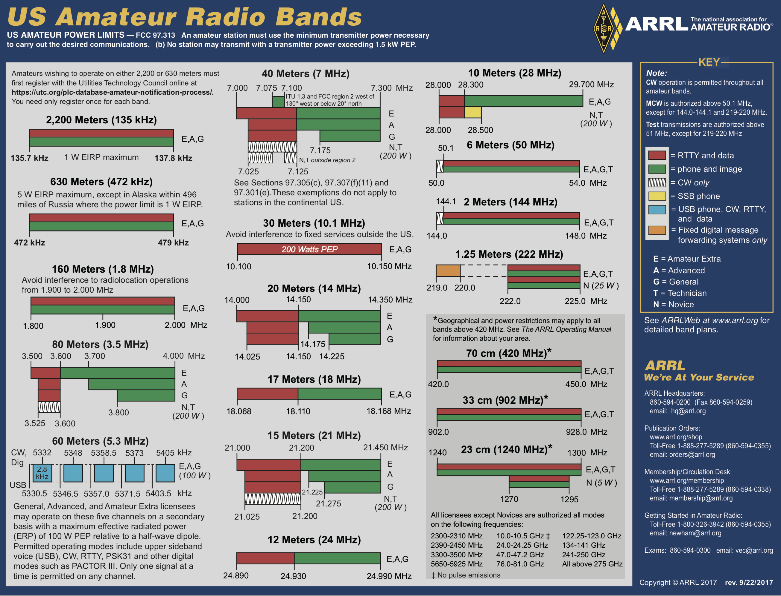

Slide 10
The Original HF Amateur Radio Bands
G1A01 General class holds all privileges on the WARC bands
1979 WARC bands added
World Administrative Radio Conference
2011 60 M added
160 M
80 M
40 M
20 M
15 M
10 M
60 M
Includes small segment reserved for Amateur Extra
30 M
17 M
12 M
30 and 60 meters have special restrictions
G1A01 (C) [97.301(d)]
On which HF/MF bands is a General class license holder granted all amateur frequency privileges?
A. 60 meters, 20 meters, 17 meters, and 12 meters
B. 160 meters, 80 meters, 40 meters, and 10 meters
C. 160 meters, 60 meters, 30 meters, 17 meters, 12 meters, and 10 meters
D. 160 meters, 30 meters, 17 meters, 15 meters, 12 meters, and 10 meters
30 meters (no phone) (no image) G1A02 G1A03
Longest no 15
60 meters (channelized). G1A04

Slide 11
30 meters (10.1 – 10.150 MHz)
60 meters. (5.3 – 5.4 MHz)
200 Watts PEP. G1C01
CW, RTTY, Data
Phone prohibited G1A02
Image prohibited. G1A03
Restricted to channels G1A04
100 watts ERP G1C14
Upper Sideband, CW, Digital
Maximum USB bandwidth
2.8 kHz. G1C03

Slide 12
What Frequencies? What Bands?
To convert band to frequencies or frequencies to bands
Remember
300 divided by frequency
Equals approximate
wavelength
300 divided by wavelength
Equals approximate
frequency
300
2ND of the highest
Frequency
(MHz)
Wavelength
Meters
G1A05
G1A06
G1A07
G1A08
G1A09
G1A02
G1A03
G1A04 oops! highest
G1A05 40MHz
G1A06
G1A07
G1A08
G1A09
G1A10 All

Slide 13
G1A01 (C) [97.301(d)]. Longest no 15
On which HF/MF bands is a General class license holder granted all amateur frequency privileges?
A. 60 meters, 20 meters, 17 meters, and 12 meters
B. 160 meters, 80 meters, 40 meters, and 10 meters
C. 160 meters, 60 meters, 30 meters, 17 meters, 12 meters, and 10 meters
D. 160 meters, 30 meters, 17 meters, 15 meters, 12 meters, and 10 meters
G1A02 (B) [97.305] 2dn of highest
On which of the following bands is phone operation prohibited?
A. 160 meters
B. 30 meters
C. 17 meters
D. 12 meters
~~
G1A03 (B) [97.305] 2nd of highest
On which of the following bands is image transmission prohibited?
A. 160 meters
B. 30 meters
C. 20 meters
D. 12 meters
~~
G1A04 (D) [97.303 (h)] oops! The highest
Which of the following amateur bands is restricted to communication only on specific channels, rather than frequency ranges?
A. 11 meters
B. 12 meters
C. 30 meters
D. 60 meters
~~
G1A05 (A) [97.301(d)] 2nd of highest after removing the ridiculous 40 MHz
Which of the following frequencies is in the General class portion of the 40-meter band (in ITU Region 2)?
A. 7.250 MHz
B. 7.500 MHz
C. 40.200 MHz out of band
D. 40.500 MHz out of band
~~
G1A06 (C) [97.301(d)] 2nd of highest
Which of the following frequencies is within the General class portion of the 75-meter phone band?
A. 1875 kHz
B. 3750 kHz
C. 3900 kHz
D. 4005 kHz out of band

Slide 14
G1A07 (C) [97.301(d)] 2nd of highest
Which of the following frequencies is within the General class portion of the 20-meter phone band?
A. 14005 kHz
B. 14105 kHz
C. 14305 kHz
D. 14405 kHz out of band
~~
G1A08 (C) [97.301(d)] 2nd of highest
Which of the following frequencies is within the General class portion of the 80-meter band?
A. 1855 kHz
B. 2560 kHz
C. 3560 kHz
D. 3650 kHz out of band
~~
G1A09 (C) [97.301(d)] 2nd of highest
Which of the following frequencies is within the General class portion of the 15-meter band?
A. 14250 kHz
B. 18155 kHz
C. 21300 kHz
D. 24900 kHz
~~
G1A10 (D) [97.301(d)]
Which of the following frequencies is available to a control operator holding a General class license?
A. 28.020 MHz
B. 28.350 MHz
C. 28.550 MHz
D. All these choices are correct

Slide 15
Courteous Operating Practices
Play nice with others
Always listen before transmitting
Ask if the frequency is clear before calling CQ
CW, send “QRL de” followed by your Call G2B06
Break in by giving your Call at a break in transmissions G2A08
When selecting a frequency, leave an appropriate distance from adjacent transmissions. Remember mode bandwidth. G2B04 G2B05
Space CW 150 to 500 Hz
SSB Approximately 3 kHz
170 Hz RTTY 250 to 500 Hz
Use the recommended voluntary band plan G2B07
No individual or net has an assigned frequency.
But be courteous to all users, and be flexible. G2B01

Slide 16
Log Book
Keep a Log
Although not required by the FCC
It helps with a reply if the FCC requests information G2D08
What should be in a log?
Date
Time
Call
Frequency
Signal reports

Slide 17
Logging is a good practice
Logs are not required by the FCC
WHY LOG?
Needed for awards and contests.
A written record to remember special contacts.
Aides in RFI investigations.

Slide 18
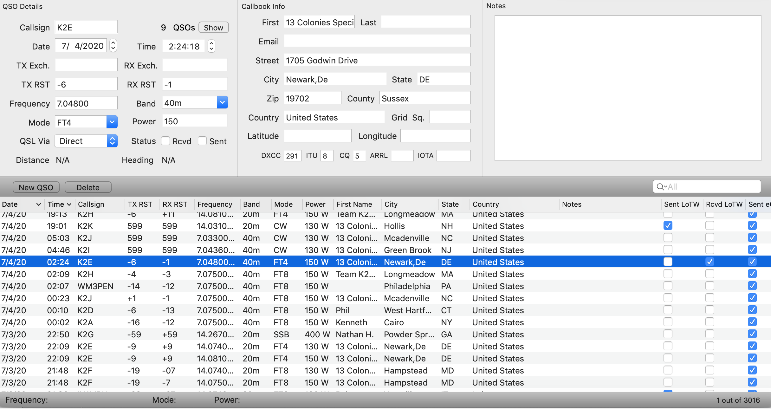

Slide 19
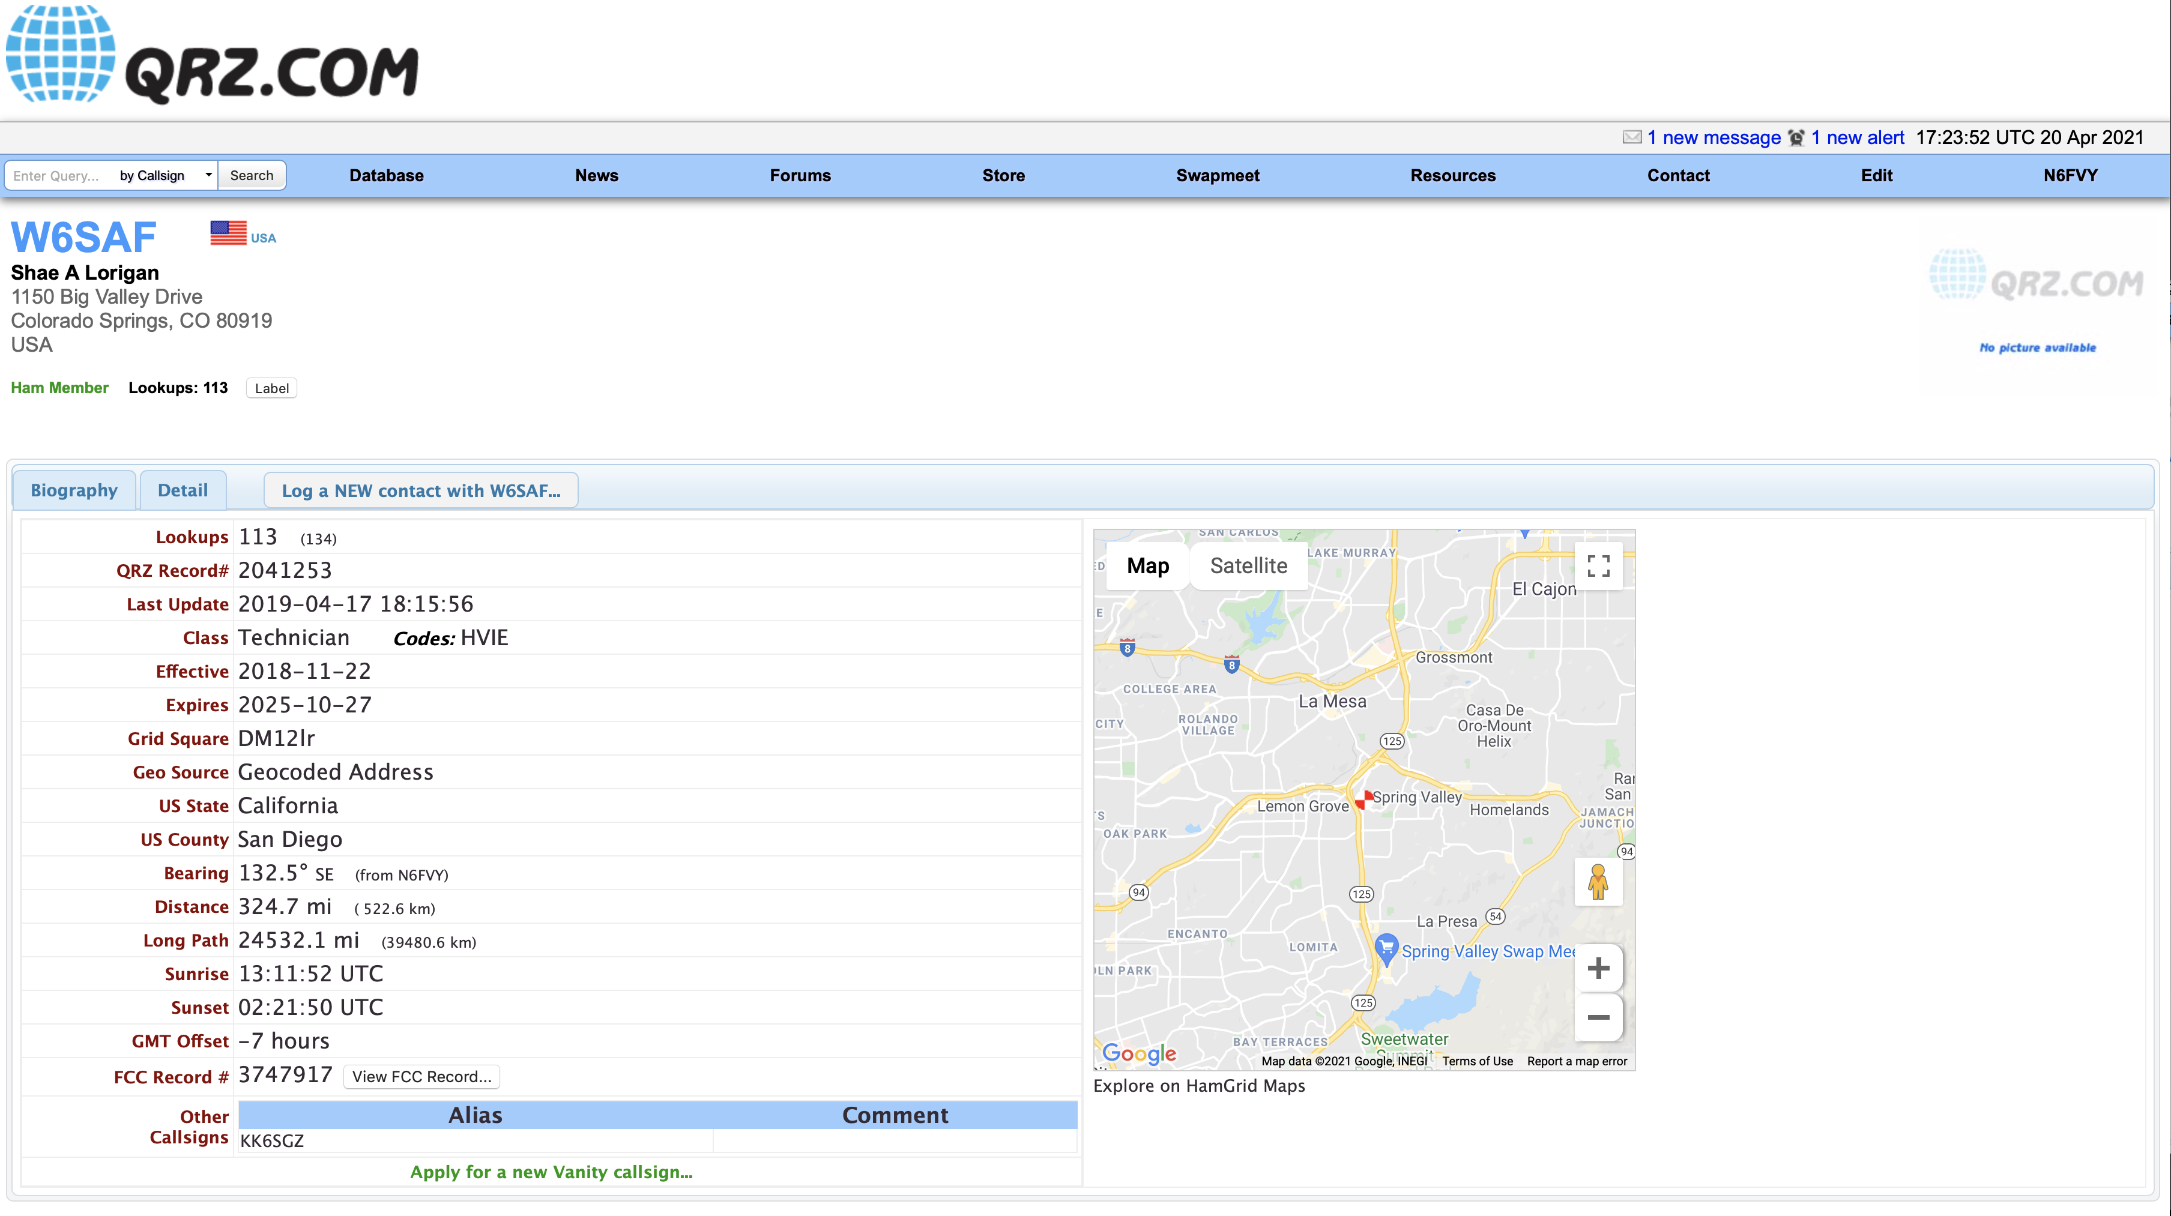
QRZ.com

Slide 20
Managing Interfance
QRM
QRN
Can change as band conditions change.
Attempt to resolve the interference problem with the other stations in a mutually acceptable manner G2B03
Notes:
T2B10 QRM

Slide 21
Dual VFO
VFO 1
VFO 2
Transmit
Receive
28.300
28.305
To permit monitoring of two frequencies G4A12
The transceiver is set to different transmit and receive frequencies G4A03
Working split

Slide 22
Bandwidth Bandwidth Bandwidth
How close to the lower edge of the phone segment should your displayed carrier frequency be when using 3 kHz wide LSB?
CW ??
150 Hz
SSB ??
3 kHz
G4D10
3kHz above
40 Mtr
How close to the upper edge of the phone segment should your displayed carrier frequency be when using 3 kHz wide USB?
7.175
3 kHz below
G4D11
20 Mtr
14.350

Slide 23
Bandwidth Bandwidth Bandwidth
What frequency range is occupied by a 3 kHz LSB signal when the displayed carrier frequency is set to 7.178 MHz
CW ??
150 Hz
SSB ??
3 kHz
G4D08
7.178
40 Mtr
What frequency range is occupied by a 3 kHz USB signal with the displayed carrier frequency set to 14.347 MHz?
7.175
3 kHz below
G4D09
14.347
20 Mtr
14.350

Slide 24
Operating CW
G2C01 – G2C11
Break in Keying (QSK)
can receive between code characters G2C01
Straight key, Paddles, and Electronic Keyers used to send a series of dots and dashes G4A10
Answer a CQ at the speed not faster than it was sent G2C05
Zero Beat – Match transmit freq. to received freq. G2C06
Restrictions of Q signals and Pro-signs
They may be used if they do not obscure the meaning of a message
G1B07
Notes:
WX= Weather GG= Going TNX= Thanks K= OK R= Affirmative CL= Clear, closing station RST-C= Key Click QSO= Conversation QRS= Send slower QRQ= Send faster QSY= Change Freq. QSL= Receipt of transmission QRT= Quit QRV= Ready QRL= Is the Freq clear?
DE= This is BT= Pause SK= Silent Key end of contact. KN= Invite specific station AR= End of message

Slide 25
G2C01 – G2C11
Abbreviate
WX, GE, TNX, K, R, CL, [RST C ]
[RST C ] Key Clicks
Q Signals
QSO, QRS, QRQ, QSY, QSL, QRT, QRV QRL
QRS Send Slower
QRL Frequency in use
QSL I acknowledge receipt
QRN I am troubled by static
QRV I am ready to receive messages
Pro Signs
DE, BT, SK, KN, AR
KN Listening only for a specific station or stations
AR End of formal message
Notes:
WX= Weather GG= Going TNX= Thanks K= OK R= Affirmative CL= Clear, closing station RST-C= Key Click QSO= Conversation QRS= Send slower QRQ= Send faster QSY= Change Freq. QSL= Receipt of transmission QRT= Quit QRV= Ready QRL= Is the Freq clear?
DE= This is BT= Pause SK= Silent Key end of contact. KN= Invite specific station AR= End of message

Slide 26
CW USB or LSB?
G4A02 (C)
What is one advantage of selecting the opposite, or “reverse,” sideband when receiving CW signals on a typical HF transceiver?
A. Interference from impulse noise will be eliminated
B. More stations can be accommodated within a given signal passband
C. It may be possible to reduce or eliminate interference from other signals
D. Accidental out-of-band operation can be prevented
G4A02
Carrier Frequency
Reduce or eliminate unwanted signals
Receiver
Bandpass
LSB
CW signals
Receiver
Bandpass
USB
CW signals

Slide 27
Notch Filter
G4A01 (B)
What is the purpose of the “notch filter” found on many HF transceivers?
A. To restrict the transmitter voice bandwidth
B. To reduce interference from carriers in the receiver passband
C. To eliminate receiver interference from impulse noise sources
D. To enhance the reception of a specific frequency on a crowded band
G4A01
Carrier Frequency
To reduce interference from carriers in the receiver passband
Receiver
Bandpass
LSB
CW signals
Receiver
Bandpass
USB
CW signals
Notch filter on

Slide 28
Digital Modes
1. Protocol
The directions for the particular mode.
How the information is coded
2. Method of modulation
FM
SSB
AFSK
PSK
Digital modes are restricted to the CW/DATA sub band.

Slide 29
Digital Modes Station Set UP
The connection between the transceiver and computer
Receive audio, transmit audio, and push-to-talk (PTT)
Soundcard
interface
Transceiver
Microphone of line input
Computer
Computer control
The sound card provides audio to the radio's microphone input and converts received audio to digital form
Most modern transceivers have built in soundcards and usb connections to connect to the computer

Slide 30
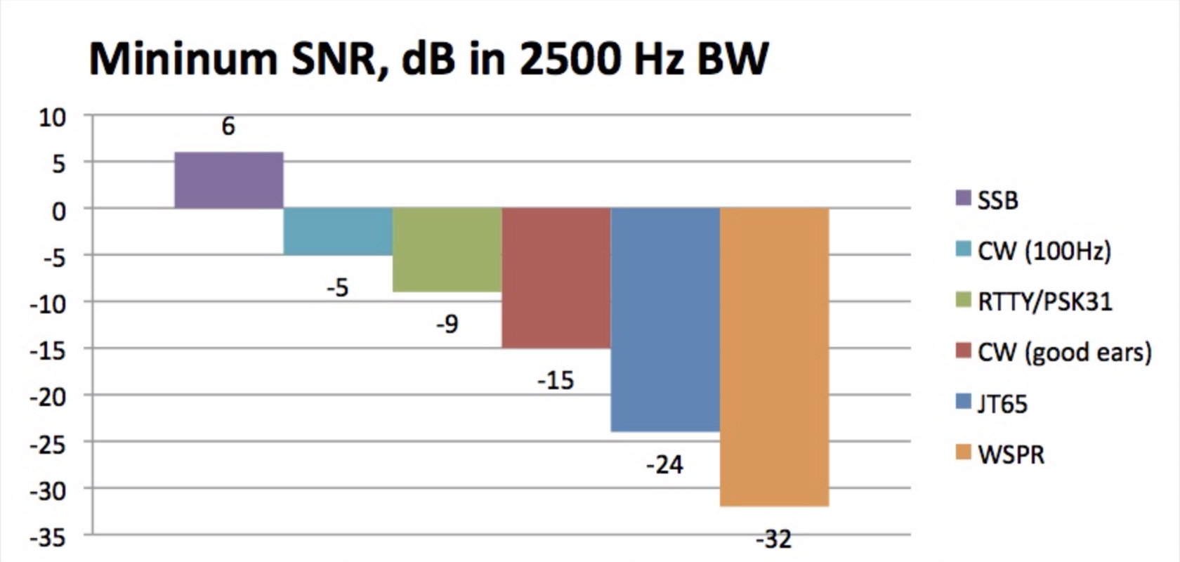
Advantages of digital

Slide 31
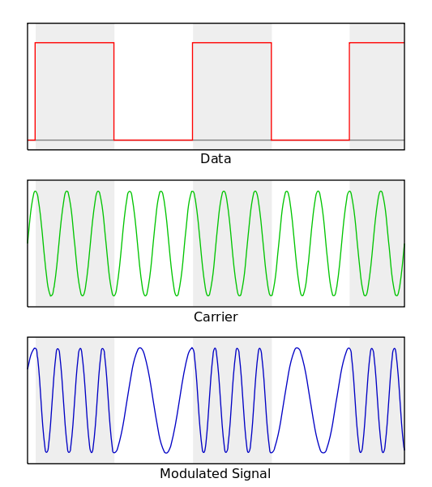
RTTY “Teletype” Narrowband direct printing telegraphy
Originated in 1930
Protocol
Uses the Baudot Code
Five bits + start and stop
FIGS and LTRS
Mark bit = 1
Space bit = 0
G2E06 Shift between mark and space = 170 Hz
On HF 45 bauds or 60 WPM most common
G8C04
G2E01 (D)
Which mode is normally used when sending RTTY signals via AFSK with an SSB transmitter?
A. USB
B. DSB
C. CW
D. LSB
Modulation
AFSK
Via LSB G2E01
Popular in all HF bands

Slide 32
PACTOR PACet Teletype Over Radio
Improvement over RTTY with the ability to detect and correct errors.
Three versions: PACTOR I, PACTOR II PACTOR III
Limited between two stations only
Can not join ongoing conversation
Limited between two stations only
Can not join ongoing conversation
G2E09
Operation
Any signals or modes can interfere with PACTOR or WINOR G2E03
NAK response from receive station = Requesting re-transmission
G8C05
Re-Tries……Timeouts…….Pauses…….Failure to connect. G2E03
Monitor without connect to check for busy G2E02
Modulation
FSK and PSK used in PACTOR III
Most common on HF for exchanging large amounts of information.
Used in Winlink email. www.winlink.com
Bandwidth 2300 Hz. G8B05
Notes:
NAK= Not Acknowledged

Slide 33
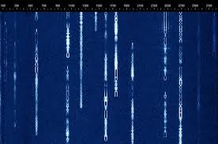
PSK31 Phase Shift Keying 31 baud
Very common on HF
Keyboard to Keyboard
Protocol
Uses a variable length code 5, 7, or 8 bits
Shorter code for common characters
Upper case letters use longer Varicode. G8C08
Called Varicode G8C12
G8C09
Advantage
Uses very narrow bandwidth
Uses computer soundcard
Modulation
Phase Shift Keying
Via SSB
Primarily USB

Slide 34
PACKET RADIO
Protocol
AX.25 protocol standard.
7 bit code + start, stop, and parity bit.
Operation
Transmitted in a group of characters (packets)
Each starts with a header. G8C03
provides information about the routing and handling.
Most common on VHF and VHF
G8C07 ERRORS Receive station responds with ARQ = Send packet again
Modulation
FSK,

Slide 35
FT8
Digital mode designed for signals with very low signal to noise ratio. G8A12
8 tone AFSK on USB G2E05 G8A09
Typical exchanges are limited to call signs, grid locators, and signal reports
G2E11
Must use computer timing accurate to 1 second. G2E15

Slide 36
Where do we find digital modes in the bands
CW and Data portions of the bands
Found in the respective band plans.
On 20 meters digital is found at 14.070 to 14.1 MHz
On 80 meters found at 3570 to 3600 kHz
G2E04
G2E07
14.000
14.070
14.112
14.150
14.350
RTTY, Data. And CW
Phone and image
E
A
14.175
G
14.025
14.225
PSK31
G2E08 PSK31 found below RTTY

Slide 37
Transmitting data
Increase data rate increase bandwidth G8B10
Maximum Symbol Rate (Baud) per Band
- 12 m 300 bauds
10 m 1200 bauds
6 and 2 m 19,600 bauds
1.25 and .70 m 56,000 bauds
G1C08
G1C10
G1C11
G1C09
Set up transmitter to transmit DATA at low power
Set ALC to Minimum
Notes:
Write on Frequency chart.

Slide 38
Emergency communications
A significant reason many become hams.
FCC Rules state:
Make “Transmissions necessary to meet essential communications needs and facilitate relief actions”
These transmissions are made on any frequency authorized to the control operator.
Two exceptions
Immediate threat to safety of life or property.
You can use any amateur radio means regardless of license class.
2. You can also use any radio communications means at your disposal.
These rules are for extraordinary situations only.
At any time during an actual emergency G2B10
.

Slide 39
Distress Calls
Acknowledge the station calling. Determine what assistance needed. G2B02
Get all accurate information, and location. Ask questions.
Contact proper authorities. Relay accurate information.
Stay on frequency for further information.
If you need to call in an emergency.
Voice, - Mayday, Mayday, Mayday.
CW, - SOS, SOS, SOS
Remember you can use any radio-communications means at your disposal

Slide 40
Emergency Comm.
Two sponsored organizations
ARES - Amateur Radio Emergency Service
Sponsored by ARRL
RACES - Radio Amateur Civil Emergency Service.
Sponsored by FEMA.
Similar missions, but different operating rules
ARES
Membership open to any licensed amateur.
Provide communications assistance to regional government relief agencies.
ARC, Salvation Army, local emergency management agencies, FEMA
RACES
Specific part of the amateur radio service.
Sponsored by FEMA
Provide communications for civil defense purposes
Usually administered by local county and state Emergency Management agencies
Must have FCC amateur radio license to be a control operator G2B09

Slide 41
G2B09
Who may be the control operator of an amateur station transmitting in RACES to assist relief operations during a disaster?
Only a person holding an FCC issued amateur operator license
B. Only a RACES net control operator
C. A person holding an FCC issued amateur operator license or an appropriate government official
D. Any control operator when normal communication systems are operational

Slide 42
G2B09
Who may be the control operator of an amateur station transmitting in RACES to assist relief operations during a disaster?
Only a person holding an FCC issued amateur operator license
B. Only a RACES net control operator
C. A person holding an FCC issued amateur operator license or an appropriate government official
D. Any control operator when normal communication systems are operational

Slide 43
Chapter 3
Rules and Regulations

Slide 44
Prohibited and Restricted Communications
Music
Profanity
False Distress Transmissions
Coded transmissions to obscure meaning of the message
Business related
Willful, Harmful, or Malicious interference

Slide 45
Regulatory Agencies
International Telecommunication Union ITU
Federal Communications Commission FCC
In conformance with good engineering and with good amateur practices G1B11
Federal Aviation Administration

Slide 46
Volunteer Examiners
VEC, Volunteer Examiner Coordinators
An agreement with FCC
ARRL is the largest VEC
Certify
VE Volunteer Examiner
G1D07 Accredited by VEC
G1D10 18 years of age or older
G1D05 Hold a General Class license or higher.
Must be listed in the FCC database
Never have had your license revoked.
Administer
Administers Exams
Must have at least 3 VE’s. G1D04
VE must hold a higher class license than the examination.
Can be a Non U.S. citizen

Slide 47
VE’s
Administer Exam
Issue
CSCE, Certificate of Successful Completion of Examination
CSCE valid for 365 days.
A Technician License holder may operate as a General upon completion and possession of CSCE
Must add an indicator to existing Call until new class is issued.
Phone, say “your Call” plus “temporary or /AG
CW, “your Call” plus /AG

Slide 48
Frequency Priviledges
MHz Bands
MHz Bands
1.8 160 m
3.5 80/75 m
7 40 m
14 20 m
21 15 m
28 10 m
50 W ERP
5 60 m 5 channels
10 30 m RTTY and Data
18 17 m
24 12 m
200 W PEP
Plus
300
Frequency
(MHz)
Wavelength
Meters
The traditional HF Bands
Added HF Bands, 1980
General class has all privileges on 160, 60, 30, 17, 12, and 10 meters
Most bands, 1500 watts PEP Maximum output power

Slide 49
How much power on HF?
The minimum power necessary to complete the communications
Power measured at the output of the transmitter or amplifier.
General, Advanced, and Extra Class
1500 Watts PEP Max
Exceptions
200 PEP Watts on the 30 meter band, (10 MHz)
50 Watts ERP on the 60 meter band, (5 MHz)
QRP = Low Power generally 10 watts or less.
QRO = Increased Power

Slide 50
Third Party Traffic
A message on behalf of another who is not an amateur radio operator
Third Party
Non Amateur or organization.
Can not have been a Ham and hand had a license suspended or revoked. G1E01
Amateur Radio Operator
Transmission
Amateur
Radio Operator
Amateur to Amateur
is never third party
Third Party

Slide 51
International Third Party
Foreign countries that allow third party with the U.S.
V2 Antigua/Barbuda
LO-LW Argentina
VK Australia
V3 Belize
CP Bolivia
E7 Bosnia-Herzegovina
PP-PY Brazil
VE, VO, VY Canada
CA-CE Chile
HJ-HK Colombia
D6 Comoros (Federal Islamic Republic of)
TI, TE Costa Rica
CM, CO Cuba
HI Dominican Republic
J7 Dominica
HC-HD Ecuador
YS El Salvador
C5 Gambia, The
9G Ghana
J3 Grenada
TG Guatemala
8R Guyana
HH Haiti
HQ-HR Honduras
4X, 4Z Israel
6Y Jamaica
JY Jordan
EL Liberia
V7 Marshall Islands
XA-XI Mexico
V6 Micronesia, Federated States of
YN Nicaragua
HO-HP Panama
ZP Paraguay
OA-OC Peru
DU-DZ Philippines
VR6 Pitcairn Island*
V4 St. Kitts/Nevis
J6 St. Lucia
J8 St. Vincent and the Grenadines
9L Sierra Leone
ZR-ZU South Africa
3DA Swaziland
9Y-9Z Trinidad/Tobago
TA-TC Turkey
GB United Kingdom
CV-CX Uruguay
YV-YY Venezuela
4U1ITU ITU - Geneva
4U1VIC VIC - Vienna

Slide 52
Making radio contacts with foreign countries
Contacts can be made provided:
Foreign Government has not notified the ITU of non contact status.

Slide 53
Beacons
Transmitting only stations for the observation of propagation
G1B03, G3B04
Rules
Must not be more than one beacon in a band from the same location G1B02
Limited to 100 watts PEP. G1B10
Avoid transmitting on 14.100, 18.110, 21.150, 24.930, 28.200
A system of propagation beacons are found on these frequencies G1E01
Low power beacons can be found in WSPR mode for HF propagation
G8C02
Automatic control beacons permitted on 10 meters and above G1B09

Slide 54
Always operate using
good amateur engineering
and
practices

Slide 55
For Next Week
Study flash cards www.hamexam.org
Radio
Fundamentals
ARRL Ch. 1, 2, 3, 6
Electricity
ARRL Ch. 4
Antennas
ARRL Ch. 7
Equipment
ARRL Ch. 5
Digital
ARRL Ch. 6
Safety
Ch. 9
Resistors
Capacitors
AC Power
Semi-
conductors
Lesson 1
G1A
G1C
G2A
G2B
G2C
G2D
G4A part
G4D part
Lesson 2
G1B
G1D
G2A
G2E
G8C
Lesson 3
G5B
G5C
Lesson 5
G4B
G4E
G6A
G6B
G7A
G7B
Lesson 6
G4E
G9A
G9B
G9C
G9D
Lesson 8/9
G4A
G4B
G4C
G4D
G7B
G7C
G8A
G8B
Lesson 10
G1E
G2E
G8A
G8B
G8C
Lesson 11
G0A
G0B
The Reactive
components
Lesson 4
G5A
G5B
G6A
G6B
Propagation
ARRL Ch. 8
Lesson 7
G3A
G3B
G3C
73
Tom and Jack

