Slide 1
Chapter 4 Cont.
Semiconductors
G4B
G4E
G6A
G6B
G7A
G7B

Slide 2
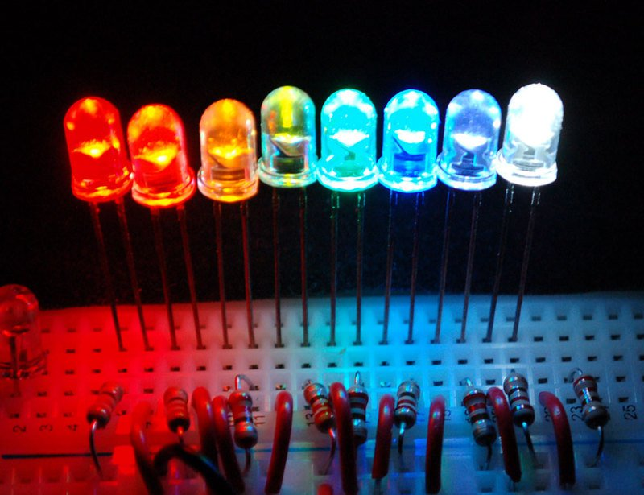
Bias
Bias is direct current ( DC ) deliberately made to flow, or DC voltage deliberately applied, between two points for the purpose of controlling a circuit .
Forward bias on a semiconductor. Current Flows
Reverse bias on a semiconductor. Current does not Flow
Forward bias a LED to light the light

Slide 3
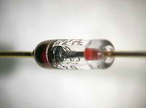
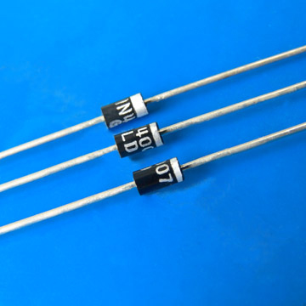
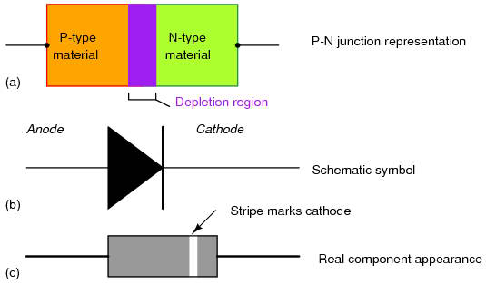
Diodes and Rectifiers One way Valves
Diodes designed for low power are often called signal or switching diodes.
Diodes designed for high power and current are called rectifiers

Slide 4
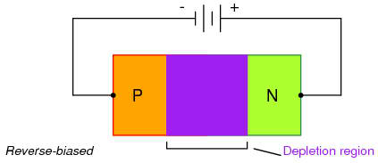
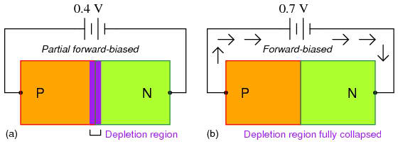
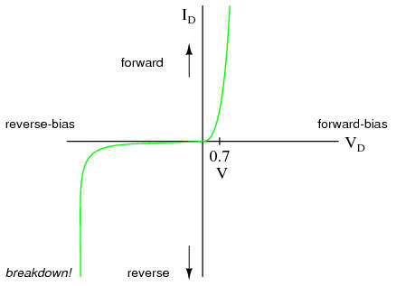
It takes a little forward voltage to cause the diode to conduct
Silicone diodes V_{F} ≈ .7 v G6A05
Germanium diodes V_{F} ≈ .3 v G6A03

Slide 5
Two diodes can be connected in Parallel to increase the current carrying capacity.
Two resistors are connected in series with the diodes to
ensure that one diode doesn't carry most of the current
E = IR
Schottky diodes for high frequencies, designed with lower internal capacitance.

Slide 6
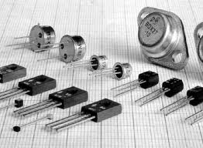
Transistors

Slide 7
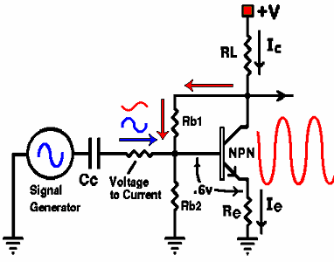
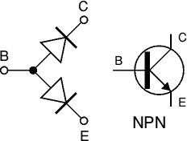
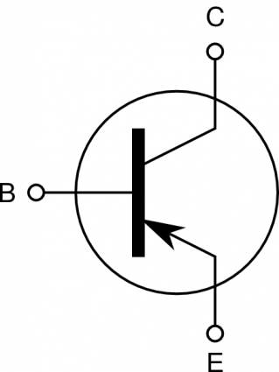
Transistors are essentially two diodes back to back.
PNP
Saturation
Transistors are amplifiers.
Cut off
Transistors can be used as a switch when operated in the saturation or cut-off region. G6A07

Slide 8
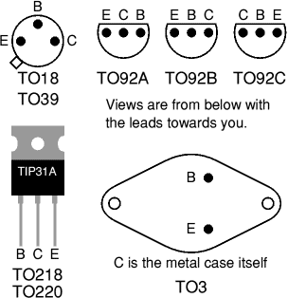
Transistor cases
The case of this transistor is the collector
Insulate the case from ground to avoid shorting the collector to ground.

Slide 9
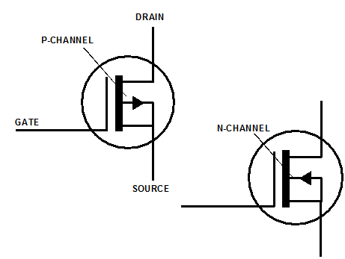
Metal Oxide Semiconductor Field Effect Transistor MOSFET
The gate is separated from the channel with a thin insulating layer. G6A09
The MOSFET and JFET use different insulating layers.
They both are very sensitive. Small amount of voltage can control source-drain current.

Slide 10
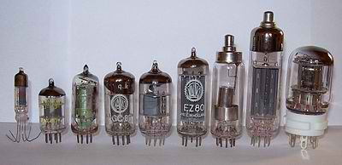
Vacuum Tubes
Tubes general operating characteristics very similar to FET transistors

Slide 11
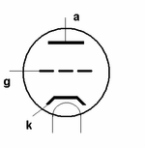
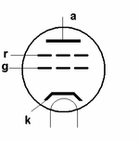
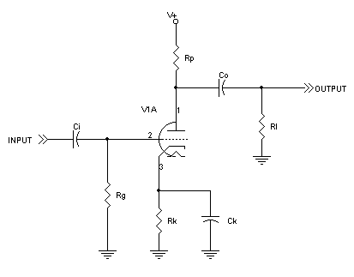
Screen grid, used to reduce grid to plate capacitance G6A12
Control grid used to control electron travel. G6A10

Slide 12
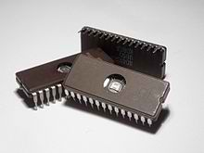
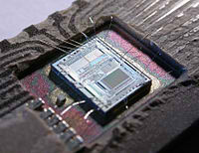
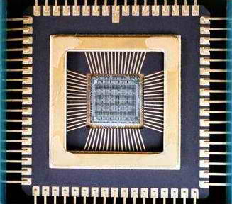
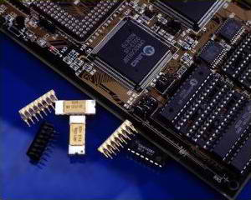
Integrated Circuits

Slide 13
RF Integrated Circuits
ICs that take the place of discrete components in RF circuits.
Such as
Amplifiers
Modulators
Mixers
De-modulators
Filters
etc.

Slide 14
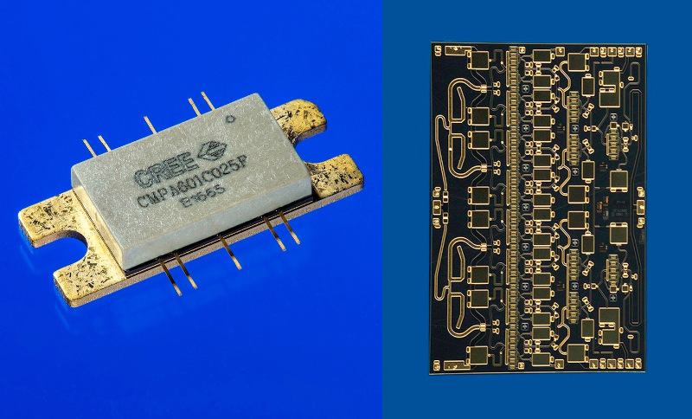
MMIC Monolithic Microwave Integrated Circuit
G6B02
integrated circuit (IC) device that operates at microwave frequencies (300 MHz to 300 GHz).

Slide 15
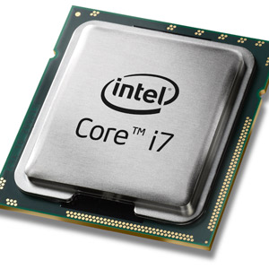
Micro Processor
An integrated circuit that contains all the functions of a central processing unit of a computer.

Slide 16
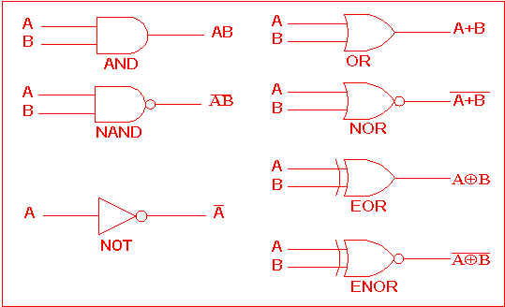
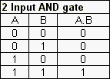
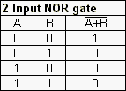
Digital Logic Basics
G7B03
G7B04

Slide 17
G7B03
Which of the following describes the function of a two input AND gate?
A. Output is high when either or both inputs are low
B. Output is high only when both inputs are high
C. Output is low when either or both inputs are high
D. Output is low only when both inputs are high
(B)

Slide 18
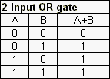
G7B04
Which of the following describes the function of a two input NOR gate?
A. Output is high when either or both inputs are low
B. Output is high only when both inputs are high
C. Output is low when either or both inputs are high
D. Output is low only when both inputs are high
(C)

Slide 19
Flip Flops
A two state digital circuit, on or off 1 or 0
To calculate the number of combinations with binary states
2^{N}
Where N is the number of bits in a string
G7B05
How many states does a 3-bit binary counter have?
A. 3
B. 6
C. 8
D. 16
(C)

Slide 20
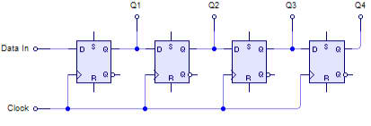
Shift Register
A clocked array of circuits that passes data in steps along the array
G7B06

Slide 21
Memory
Volatile
(Random Access Memory)
RAM
SRAM
DRAM
Non-volatile
(Read only memory) G6B04
ROM
EPROM
PROM
CD-ROM
Flash
Memory is erased after power is removed
Memory remains stored even after power is removed G6B05

Slide 22
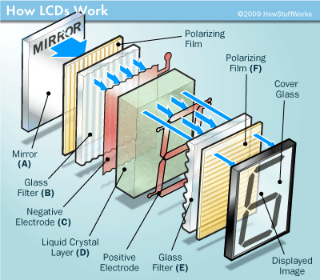
Visual Interface
Incandescent lights
LEDs
(low power)
(forward bias)
G6B08
Displays
Liquid /crystal Display (LCD)
Utilizes ambient or back lighting
G6B09

Slide 23
Practical Circuits
The Power Supply
Rectifier circuits
@ 60 cycles
Half Wave
Only use one half or 180⁰
of the input sine wave.
G7A05
Unfiltered output = 60 PPS
Rectifier diode PIV = 2 X peak V.
Only one diode is required G7A04
Full Wave
Uses the full input sine wave
360⁰
G7A06
Unfiltered output = 120 PPS
Requires center tapped transformer
Rectifier diode PIV = 2 X peak V.

Slide 24
Power Supply Filter circuit
Power supply filter networks commonly use capacitors and inductors. G7A02
A well designed and safe power supply would incorporate a bleed resistor. G7A01

Slide 25
Half Wave
+
-
E_{RMS}
+
-
Half-wave PS only uses one diode (Advantage)? G7A04
Only 180 degrees of the input signal is converted to DC G7A05
A series of DC pulses at twice the input frequency G7A07
Full Wave.
E_{RMS}
A Full-wave PS uses two diodes and a center tapped transformer. G7A03
Output frequency is twice the input frequency G7A07
360 degrees of the input signal is converted to DC G7A06

Slide 26
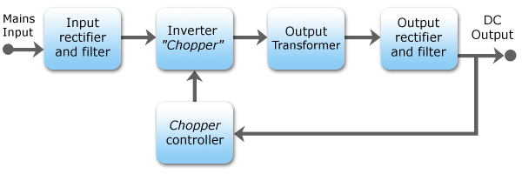
Switching Power Supplies
(C)
G7A08
Which of the following is an advantage of a switch-mode power supply as compared to a linear power supply?
A. Faster switching time makes higher output voltage possible
B. Fewer circuit components are required
C. High frequency operation allows the use of smaller components
D. All of these choices

Slide 27
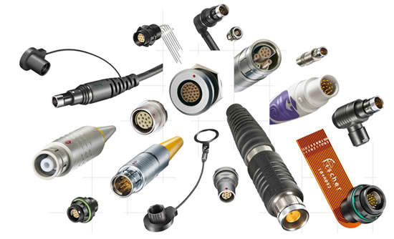
Connectors
Keyed connectors prevent improper mating of connectors
RCA or phono jacks commonly used for audio, video, an low level RF signals. G6B12
DIN connectors is a family of multiple circuit connectors suitable for audio and control signals.
RF connectors
PL-259 Commonly used RF connector for frequencies up to 150 MHz G6B13
Type N A moisture-resistant RF connector useful to 10 GHz G6B07
SMA A small threaded connector suitable for signals up to several GHz G6B11

Slide 28
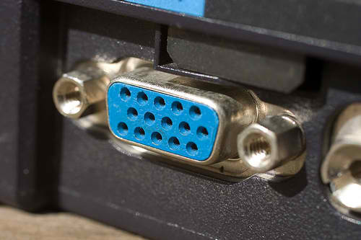
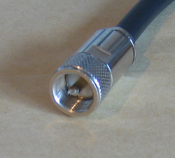
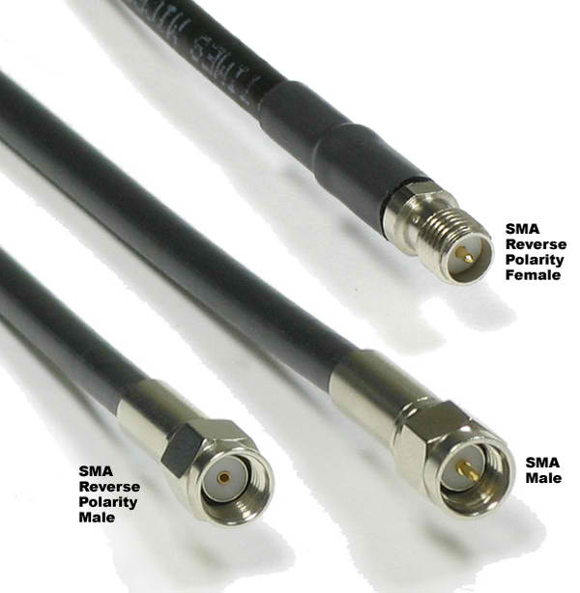
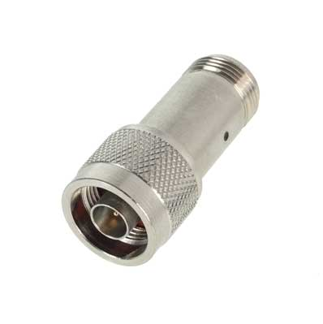
Which of the following connectors would be a good choice for a serial data port?
A. PL-259
B. Type N
C. Type SMA
D. DE-9

Slide 29
Basic Test Equipment
Digital and analog multi-meters.
Sometimes analog meters are preferred to digital when adjusting tuned circuits G4B14
Both digital and analog meters should have a high impedance input to decrease loading of a circuit. G4B05
Oscilloscopes
For measuring fast changing and complex waveforms. G4B02
Contains both horizontal and vertical channel amplifiers. G4B01
For measuring a transmitters waveform the RF is connected to the attenuated output of the transmitter. G4B04
Oscilloscope is useful for measuring the keying waveform. G4B03

Slide 30
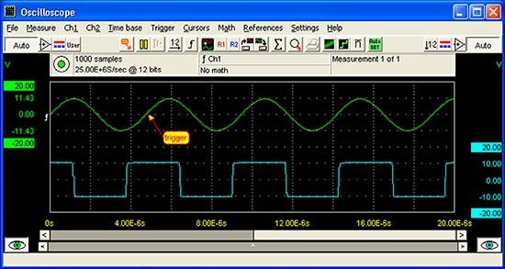
O-Scope Image

Slide 31
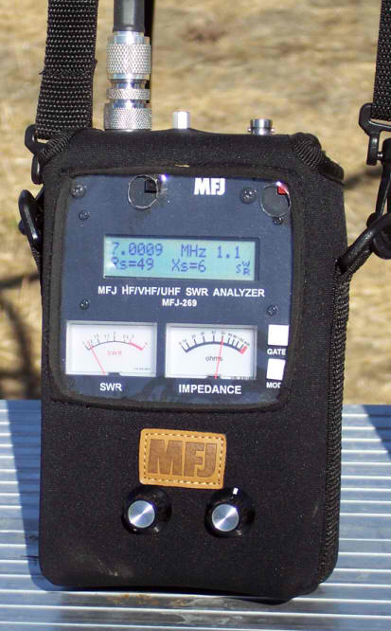
Impedance and Resonance Measurement
Antenna Analyzer
Produces a signal at a frequency within a tuning range
Receives the frequency as it is reflected back from the connected load
Connected directly to the antenna feed-line and antenna, it will measure SWR and antenna resonance. G4B11
An analyzer also can determines the impedance of an unknown or unmarked coaxial cable G4B13
Strong signals from nearby transmitters can affect accuracy G4B12

Slide 32
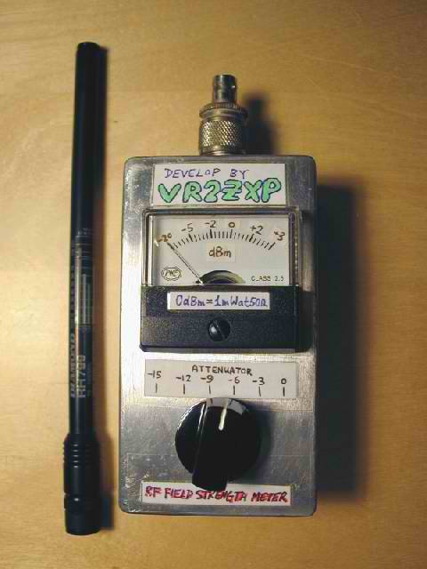
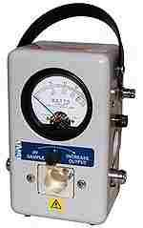
Field Strength
Measures relative RF output when adjusting transmitters G4B08
Power Meters
Measures forward and reflected RF power
This measurement will you to calculate SWR G4B10

Slide 33
Alternative Power
Solar Cells
Photovoltaic conversion G4E08
PN junction silicon
Open circuit voltage across the junction is .5 volt. G4E09
Conversion factor about 20%
1 sq. meter almost 1 kW
Storage
Power generated from solar and wind needs to be stored for when there is no wind or solar energy. G4E11
Storage batteries are commonly used.
Diodes are put in series with the solar panels to prevent discharge back into the solar panel. G4E10

Slide 34
Batteries and Chargers
Two classifications of batteries
Primary
Disposable batteries
Secondary
Chargeable batteries
Nickel cadmium NiCd
Nickel metal hydride NiMH
Lithium-ion Li-ion
Lead acid
Lead acid or storage batteries should not be discharged below approximately 10.5 volts
Low internal resistance in NiCd batteries allow for high current draw P=I²R

Slide 35
Which symbol in figure G7-1 represents a field effect transistor?
1

Slide 36
Which symbol in figure G7-1 represents a Zener diode?
5

Slide 37
Which symbol in figure G7-1 represents an NPN junction transistor?
2

Slide 38
Which symbol in Figure G7-1 represents a solid core transformer?
6

Slide 39
Which symbol in Figure G7-1 represents a tapped inductor?
7

