Slide 1
Digital Modes

Slide 2
Digital Modes
1. Protocol
The directions for the particular mode.
How the information is coded
2. Method of modulation
FM
SSB
AFSK
PSK
Digital modes are restricted to the CW/DATA sub band.

Slide 3
Where do we find digital modes in the bands
CW and Data portions of the bands
On 20 meters digital is found at 14.070 to 14.1 MHz
On 80 meters found at 3570 to 3600 kHz
G2E04
G2E07
14.000
14.070
14.112
14.150
14.350
RTTY, Data. And CW
Phone and image
E
A
14.175
G
14.025
14.225
PSK31
G2E08 PSK31 found below RTTY

Slide 4
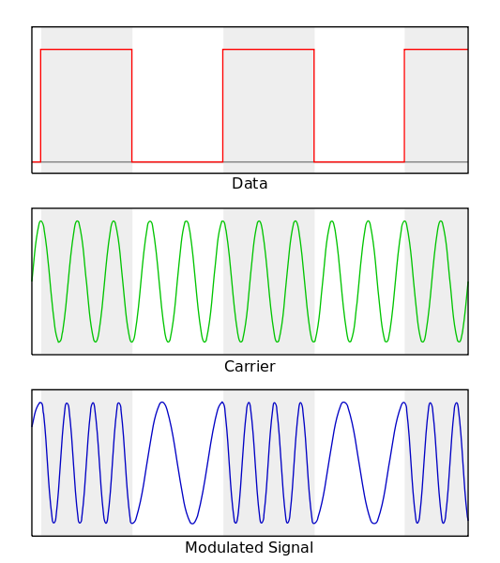
RTTY “Teletype” Narrowband direct printing telegraphy
Popular in all HF bands
Originated in 1930
Protocol
Uses the Baudot Code
Five bits + start and stop
G2E06 Shift between mark and space = 170 Hz
On HF 45 bauds or 60 WPM most common
G8C04
Modulation
AFSK
Via LSB G2E01
Cannot decode an RTTY or other FSK signal even though it is apparently tuned in properly?
A. The mark and space frequencies may be reversed
B. You may have selected the wrong baud rate
C. You may be listening on the wrong sideband
AOTA

Slide 5
PACTOR Packet Teletype Over Radio
Improvement over RTTY with the ability to detect and correct errors.
Three versions: PACTOR I, PACTOR II PACTOR III
Limited between two stations only
Can not join ongoing conversation
G2E09
Limited between two stations only
Can not join ongoing conversation
Operation
Any signals or modes can interfere with PACTOR or WINOR G2E03. AOTA
NAK response from receive station = Requesting re-transmission
G8C05
Re-Tries……Timeouts…….Pauses…….Failure to connect. G2E03
Monitor without connect to check for busy G2E02
Modulation
FSK and PSK used in PACTOR III
Most common on HF for exchanging large amounts of information.
Used in Winlink email. www.winlink.com. G2E13
Bandwidth 2300 Hz. G8B05
Notes:
NAK= Not Acknowledged

Slide 6
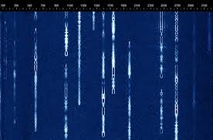
PSK31 Phase Shift Keying 31 baud
Very common on HF
Keyboard to Keyboard
Protocol
Uses a variable length code 5, 7, or 8 bits
Shorter code for common characters
Upper case letters use longer Varicode. G8C08
Called Varicode G8C12
G8C09
Advantage
Uses very narrow bandwidth
Uses computer soundcard
Modulation
Phase Shift Keying
Via SSB

Slide 7
Packet Radio
Protocol
AX.25 protocol standard.
7 bit code + start, stop, and parity bit.
Operation
Transmitted in a group of characters (packets)
Each starts with a header. G8C03
provides information about the routing and handling.
Most common on VHF and VHF
G8C07 ERRORS Receive station responds with ARQ = Send packet again
Modulation
FSK,

Slide 8
FT8
Joe Taylor WSJT-X
JT65, JT9, FT8 use USB
Digital mode designed for signals with very low signal to noise ratio. G8A12
8 tone AFSK on USB G2E05 G8A09
Typical exchanges are limited to call signs, grid locators, and signal reports
G2E11
Must use computer timing accurate to 1 second. G2E15

Slide 9
Transmitting data
Increase data rate increase bandwidth G8B10
Maximum Symbol Rate (Baud) per Band
- 12 m 300 bauds
10 m 1200 bauds
6 and 2 m 19,600 bauds
1.25 and .70 m 56,000 bauds
G1C08
G1C10
G1C11
G1C09
Notes:
Write on Frequency chart.

Slide 10
Videos
RTTY
https://www.youtube.com/watch?v=gZx8IcHrLwo
PSK 31
https://www.youtube.com/watch?v=ymo91kP1Fpo

