Slide 1
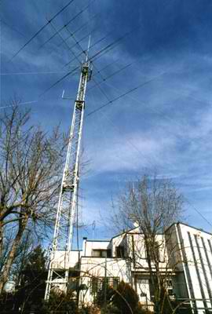
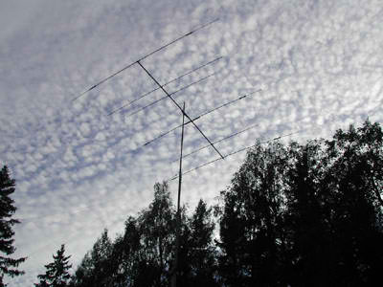
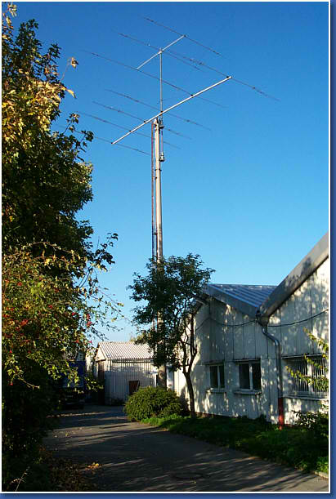
Lesson 4 Propagation, Antennas, Feed Lines
G. West
Weak signal propagation p. 93
Antennas p. 171
Feed Me With Some Good Coax p. 179
ARRL: Ch. 4

Slide 2
The Sky Above
-ISS
414 mi
260 mi
Ionosphere
30 mi.
Weather

Slide 3
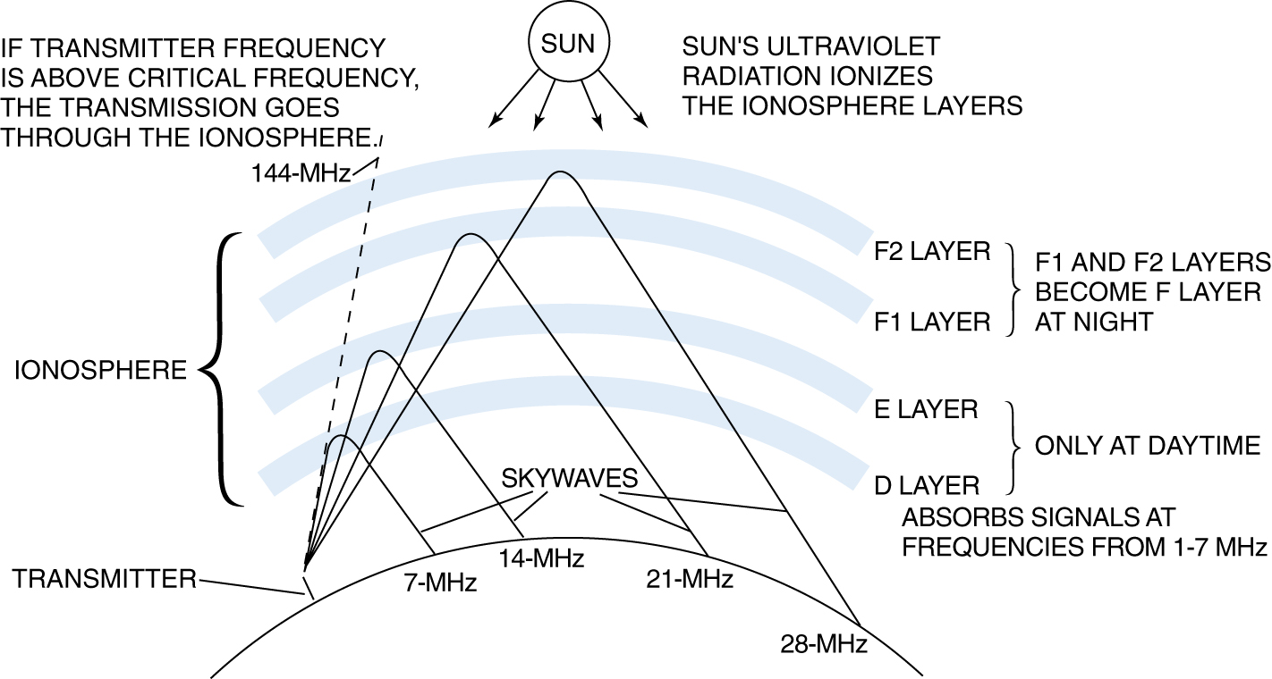
Learn your D, E, F’s
T3A11 The ionosphere is the part of the atmosphere that enables the propagation of radio signals around the world.
Each reflection is called a hop.
30 to 260 miles
Ionosphere and its layers

Slide 4
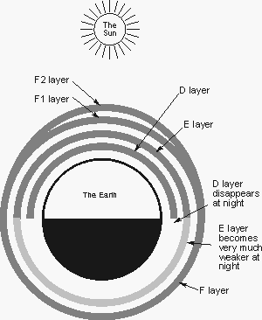
Ionosphere Layers

Slide 5
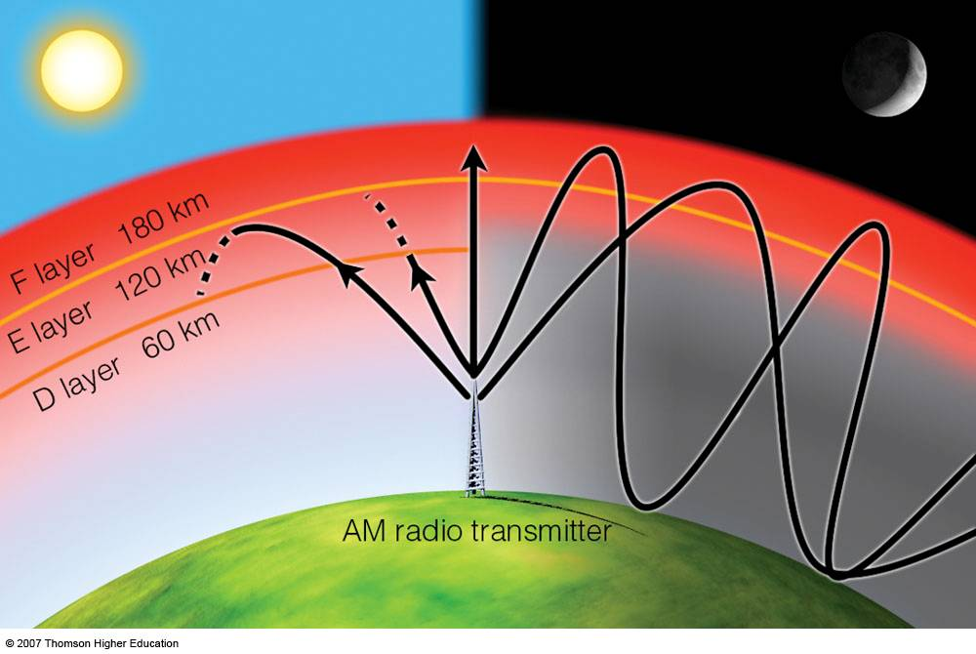
Absorption

Slide 6
Radio Waves
T5C07 T3A07 Radio waves is the usual name for electromagnetic waves that travel through space.
Irregular ionospheric signal fading can be caused by random combining of signals arriving via different paths T3A08

Slide 7
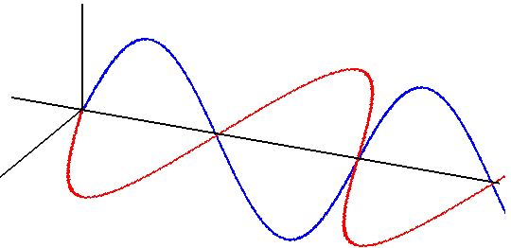
RADIO WAVES
• Electromagnetic radiation comprises both an Electric and a Magnetic
Field.
• The two fields are at right-angles to each other and the direction of
propagation is at right-angles to both fields.
• The Plane of the Electric Field defines the Polarization of the wave.
T3B02
Electric
Field, E
X
Y
Magnetic
Field, H

Slide 8
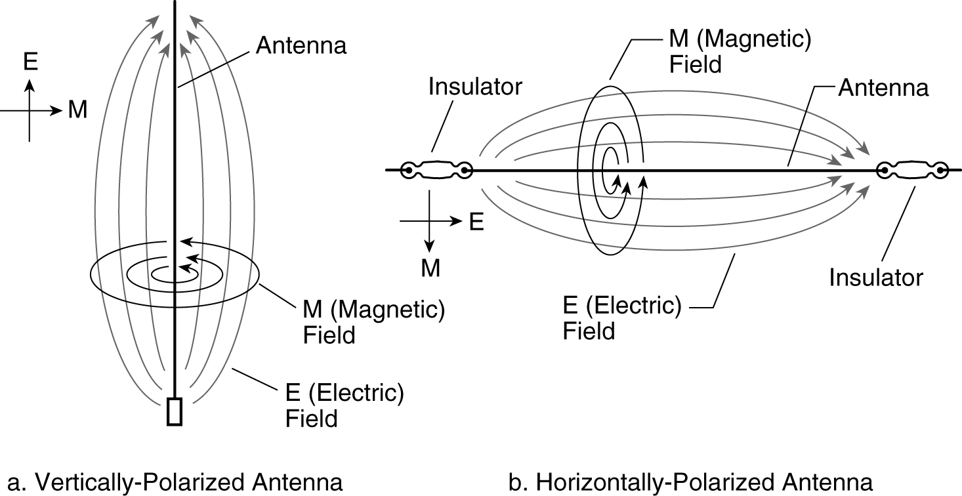
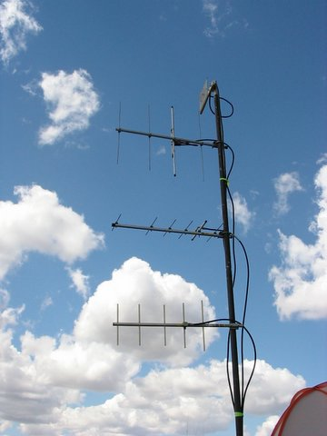
Vertical and Horizontal Polarization
H & V Polarized Antennas
Signals could be significantly weaker if opposite ends of a VHF or UHF line of sight radio link are not using the same polarization T3A04

Slide 9
VHF
Quiz
UHF
Very High Frequency
Meaning?
Ultra High Frequency
30 – 300 MHz
Freq Range?
300 – 3000 MHz
Mode for
Repeaters?
FM
FM
2 meter
frequency range?
144 – 148 MHz
70 cm
frequency range?
420 – 450 MHz
2 meter simplex
calling frequency?
146.52 MHz
70 cm simplex
calling frequency?
446.000 MHz
UHF signals are usually not reflected by the ionosphere. T3C01

Slide 10
VHF & UHF
 | VHF |  |  | UHF
30 MHz |  |  | 300 MHz
 | CHP |  | 420 MHz | 70 cm | 450 Mhz
 |  |  |  | FRS/GMRS
50 MHz | 6 Meters | 54 MHz
 | TV
88 | FM
 | Broadcast | 108 | 902 MHz | 33 cm | 928 MHz
 | TV
 | Aviation
 | Aviation |  |  | Cell Phone
 | Military |  | 1240 MHZ | 23 cm | 1300 MHz
144 MHz | 2 Meters | 148 MHz
 | Municipal
219 MHz | 1.25 Meters | 225 MHz
300 MHz |  |  | 3000 MHz
Technician class home range |  |  | Technician class home range
6 meters the un-predictable band |  |  | Line of sight communications
Line of sight communications |  |  | Suited for repeater operation
Suited for repeater operation |  |  | 70 cm suited for mobile and portable
FM and digital modes.
Suited for mobile and portable comm.
2 mtr SSB and CW at lower band edge
Satellite and EME |  |  | Satellite and EME

Slide 11
VHF and UHF Radio Waves
The distance at which radio signals between two points are effectively blocked by the curvature of the Earth, is the radio horizon.
VHF & UHF radio signals will generally travel “line of sight.”
VHF & UHF radio signals are blocked by the curvature of the Earth.
T3C11 VHF and UHF radio signals usually travel somewhat farther than the visual line of sight distance between two stations because the Earth seems less curved to radio waves than to light.
1.23 x √ h
Miles feet

Slide 12
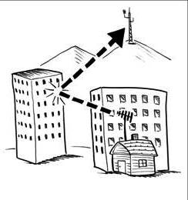
Two Meter Ball in the Side Pocket
T3A05 When using a directional antenna, your station might be able to access a distant repeater if buildings or obstructions are blocking the direct line of sight path by finding a path that reflects signals to the repeater.
Directional Antenna can be used to bounce signal to reach repeater blocked by building

Slide 13
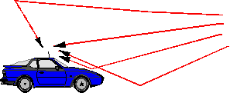
Multipath
T3A01 Should another operator reports that your stations 2 meter signals were strong just a moment ago, but now they are weak or distorted, try moving a few feet, as random reflections may be causing multi-path distortion.
T3A06 Rapid fluttering from multipath while moving is called picket-fencing
T3A10 Error rates are likely to increase on VHF or UHF data signals propagated over multiple paths.

Slide 14
Propagation and Weather
Our weather occurs in the troposphere and the stratosphere. This is the region below the ionosphere. This region has an effect on the higher frequencies in the VHF above 50 MHz and UHF range.
Precipitation will decrease the range of microwave frequencies. T3A13
Fog and rain would have no affect on 10 and 6 meters. T3A12
VHF and UHF signals be greater in the winter because Less absorption by vegetation T3A02

Slide 15
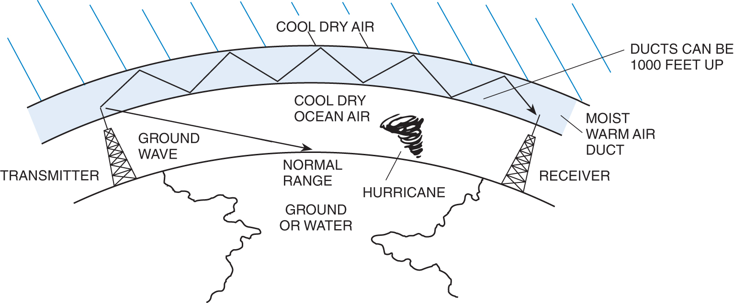
Ducting
T3C08 Temperature inversions in the atmosphere causes "tropospheric ducting".
Tropospheric Ducting

Slide 16
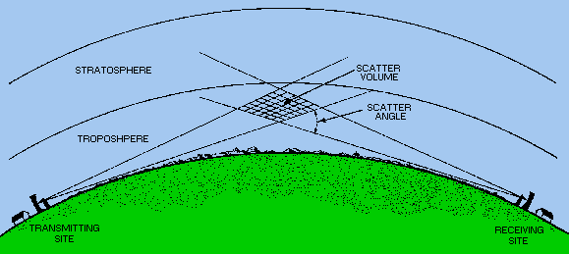
Tropospheric Scatter
T3C06 Tropospheric scatter is responsible for allowing over-the-horizon VHF and UHF communications to ranges of approximately 300 miles on a regular basis.
Tropospheric

Slide 17
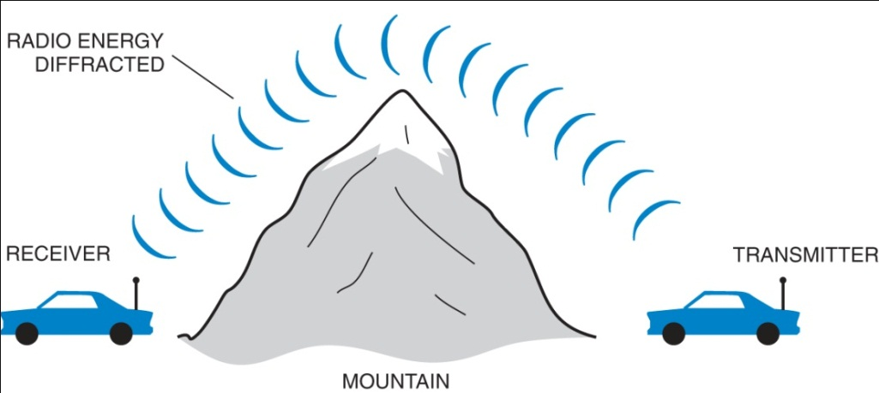
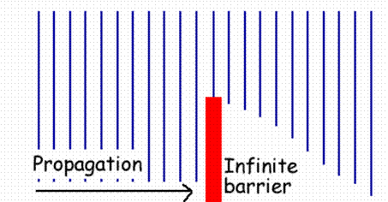
Knife-Edge Diffraction
T3C05 The term "knife-edge" propagation refers to signals that are partially refracted around solid objects exhibiting sharp edges.

Slide 18
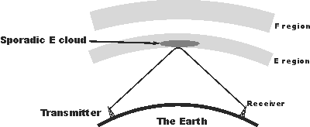
Sporadic E
T3C04 Sporadic E propagation is most commonly associated with occasional strong over-the-horizon signals on the 10, 6, and 2 meter bands. VHF band.

Slide 19
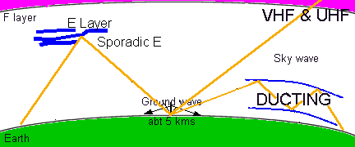
Sporadic E
Up to 1500 mi.
300 mi +

Slide 20
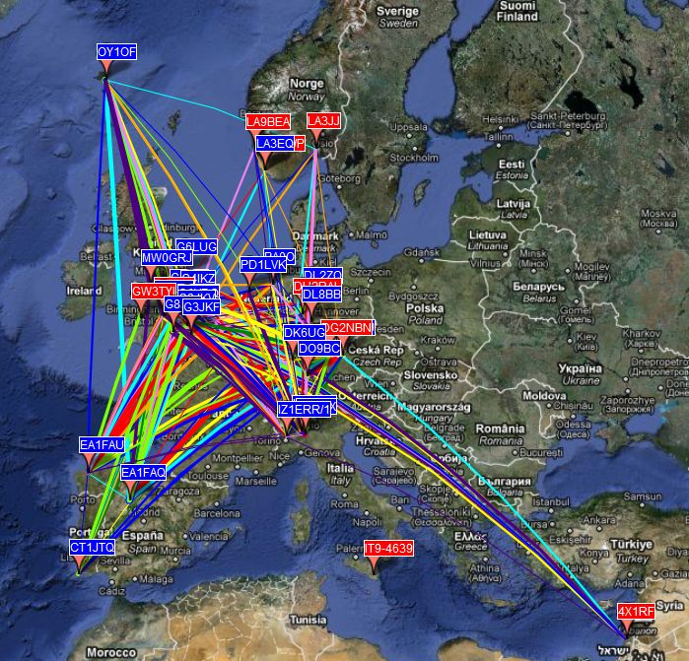
DL2YMR
Sporadic E 10 meters
2010

Slide 21
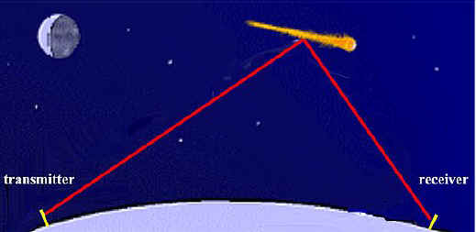
Meteor Scatter
T3C07 The 6 meter band is best suited to communicating via meteor scatter.
Leonids and Geminids meteor showers provide these conditions

Slide 22
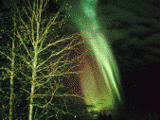
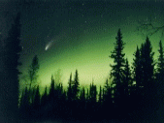
Aurora
T3C03 A characteristic of VHF signals received via auroral reflection is that the signals exhibit rapid fluctuations of strength and often sound distorted.
Incoming signals from a distant station heard hundreds of miles away will sound fluttery and distorted by auroral bounce

Slide 23
HF
Quiz
Quiz
Meaning?
High Frequency
Freq Range?
3 – 30 MHz
Most common
Voice Mode ?
SSB
SSB
Bandwidth?
3 kHz
One advantage of HF vs. VHF and higher frequencies? T3C02
Long distance ionospheric propagation is far more common on HF

Slide 24
HF
 | HF
3 MHz
3.5 MHz | 80 Meters | 4 MHz
5.33 MHz | 60 Meters | 5.4035 MHz
7 MHz | 40 Meters | 7.3 MHz
Lower sideband
Upper sideband
10.1 MHz | 30 Meters | 10.150 MHz
14 MHz | 20 Meters | 14.350 MHz
 | 17 Meters
 | 15 Meters
 | 12 Meters
 | CB
28 MHz | 10 Meters | 29.7 MHz
30 MHz
Primary General and Extra Class privledges
Limited Technician privileges |  | SSB on 10 M
CW on 40 and 15 meters
Long distance communications
Large antennas.
Day to night from upper to lower freq.
60 and 30 meter special restrictions
Solar activity critical
T3C10 During daylight hours and the peak of the solar cycle is generally the best time for long-distance communications on 10 and 6 meter bands.

Slide 25
Learn your D, E, F’s
T3A11 The ionosphere is the part of the atmosphere that enables the propagation of radio signals around the world.
Each reflection is called a hop.
30 to 260 miles
Ionosphere and its layers

Slide 26
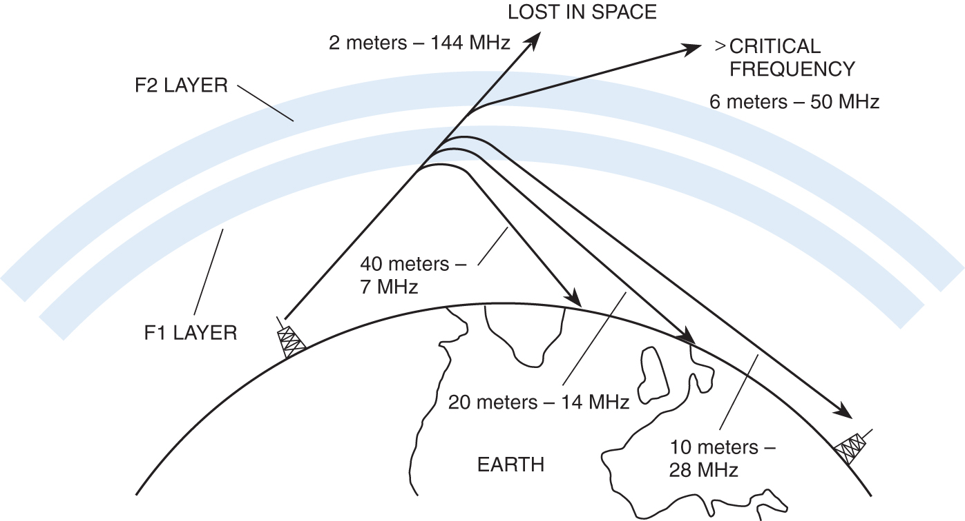
Skip
T3A09 “Skip” signals from the ionosphere become elliptically polarized.
Skip happens when signals refract and reflect off the ionosphere.
DX stations 1000 miles away come booming in.
Every 30 seconds signal goes from strong to weak and back.
Caused by random, ever changing polarization of the original signal.
Either vertical or horizontal polarized antennas can be used.
26

Slide 27
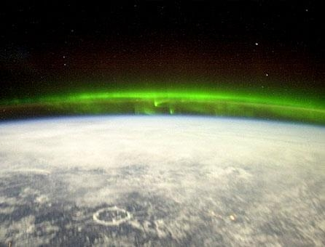
Ionosphere from space

Slide 28
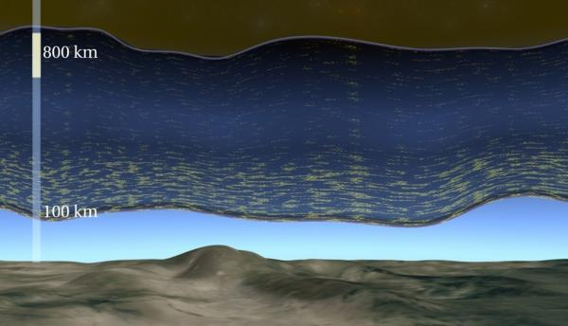
Ionosphere

Slide 29
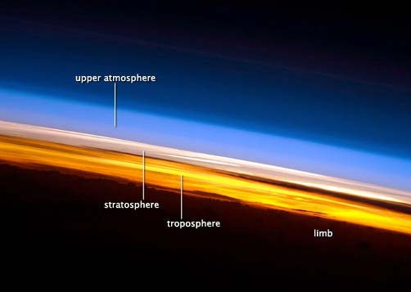
ISS Image
Notes:
Latin, limbus border

Slide 30
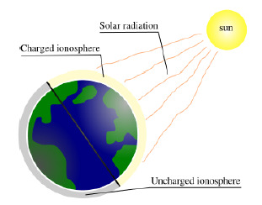
What is the greatest influence on HF propagation?
Solar radiation
Charged ionosphere
Uncharged ionosphere

Slide 31
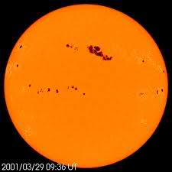
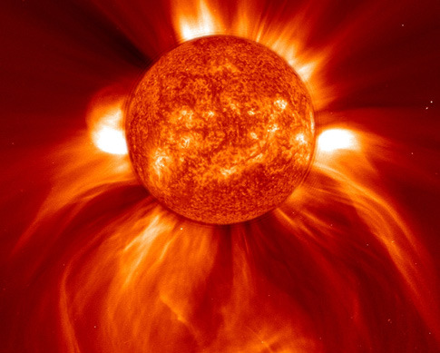
Solar indices
http://dx.qsl.net/propagation/
Coronal Mass Ejections (CME)
Sun Spot activity - approximate 11 year cycle
Solar Flux, (Index) SFI : is a measure of the radio
energy emitted from the sun. Values 50 to 300. //the higher the better
K index, disturbances in the horizontal component of earths magnetic field. Values 0 to 9
A index, related to K in an averaging, values 0 t0 400
Notes:
The most critical factor affecting radio propagation is solar activity and the sunspot
cycle. Sunspots are cooler regions where the temperature may drop to a frigid
4000K. Magnetic studies of the sun show that these are also regions of very high
magnetic fields, up to 1000 times stronger than the regular magnetic field.
• Our Sun has sunspot cycle of about 22 years which reach both a minima and
maxima (we refer to a 11 year low and high point or cycle). When the sunspots
are at their maximum propagation is at its best.
• Ultraviolet radiation from the sun is the chief (though not the only) source of

Slide 32
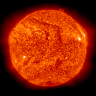
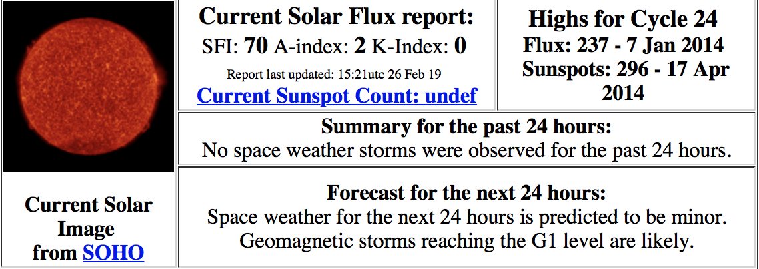
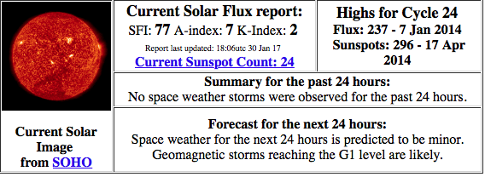
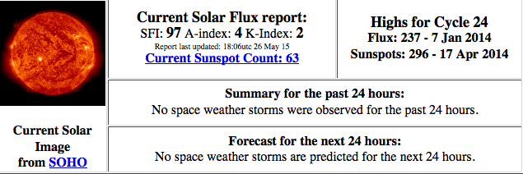
Today’s SFI
Solar Flux Index (SFI) - Higher numbers mean better propagation.
Highs for Cycle 24 Flux: 190 - 24 Sep 2011 Sunspots: 208 - 9 Nov 2011
Summary for the past 24 hours: No space weather storms were observed for the past 24 hours.
Lower A index means better propagation.
K-Index - Falling numbers mean improving conditions and better propagation

Slide 33
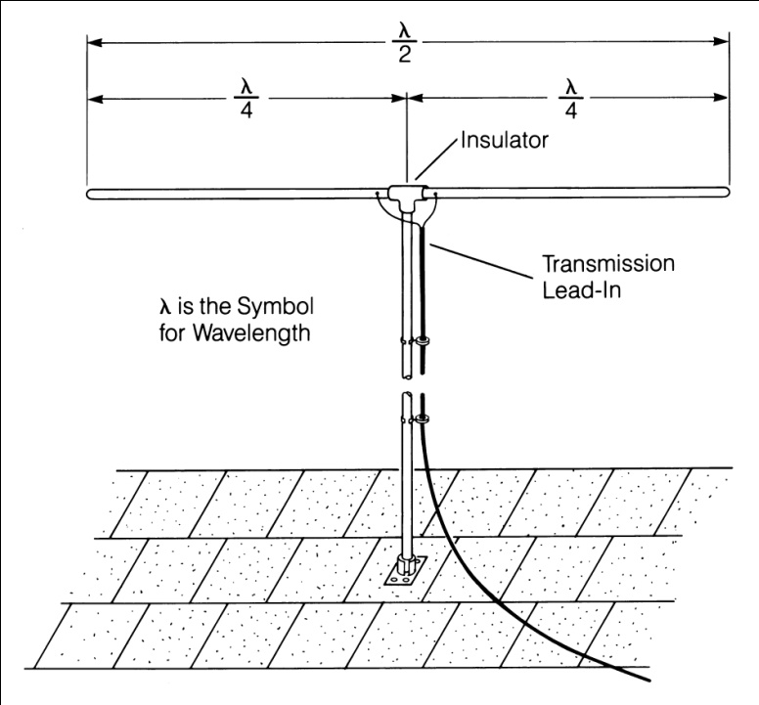
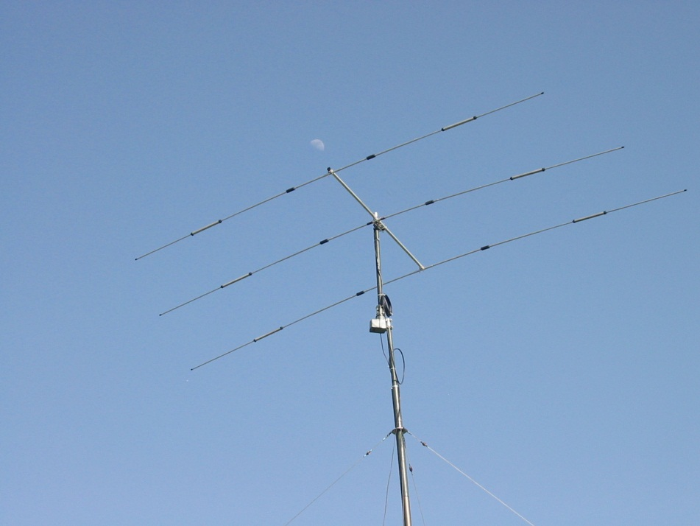
Antennas
T9A03 A simple dipole mounted so the conductor is parallel to the Earth's surface is a horizontally polarized antenna.
Simple Dipole
Three element beam
33

Slide 34
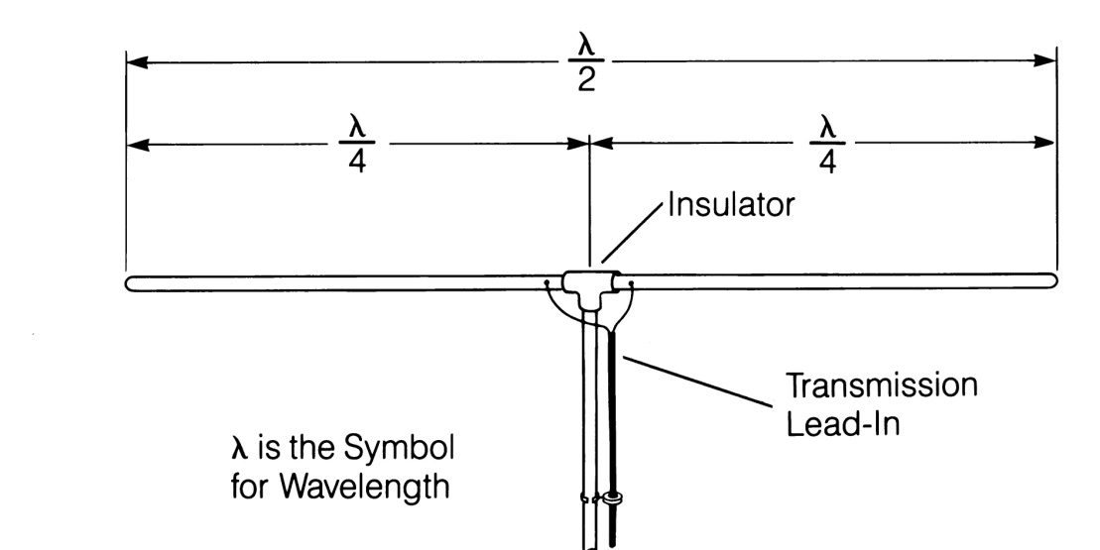
Size Matters
6
50
112
236
T9A09
T9A09 The approximate length of a 6 meter 1/2-wavelength wire dipole antenna in inches is ?
112 inches
6 meters / 2 = 3 m
(1 meter ≅ < 40 inches)
40 inches X 3
= < 120 inches
Six Meter ½ Wavelength Dipole
T9A10 The strongest radiation from a half-wave dipole antenna
in free space is broadside to the antenna.
34

Slide 35
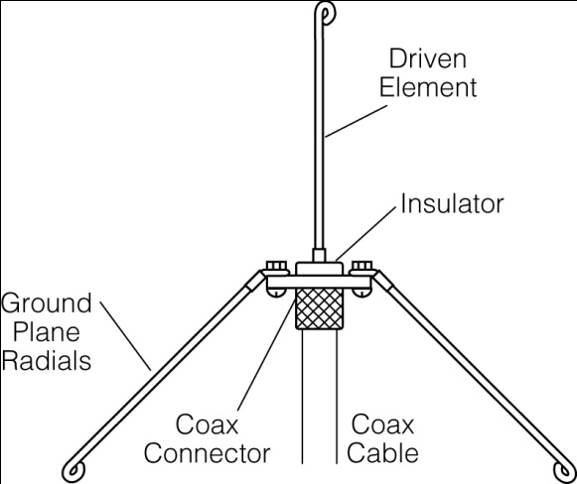
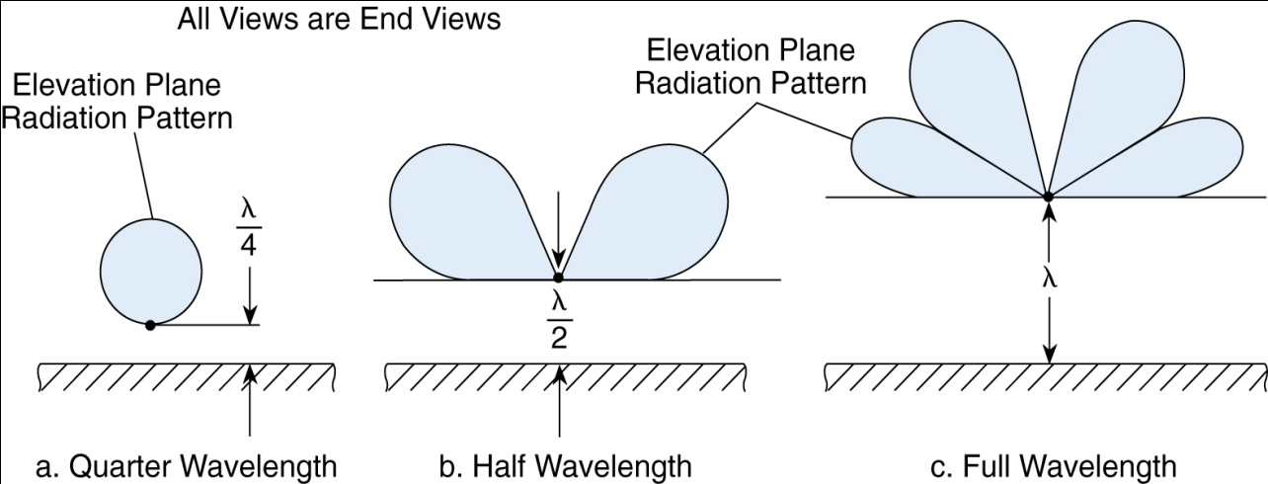
112
50
19
12
T9A08
T9A08 The approximate length of a quarter-wavelength vertical antenna for 146 MHz in inches is?
2 meters
/4 =
½ meter
< 20 inches
(1 meter ≅ < 40 inches)
19”
Radiation Pattern of an Antenna Changes as Height Above Ground is Varied
35

Slide 36
Dipole Antenna
How would you change a dipole antenna to make it resonant on a higher frequency? T9A05
Shorten it

Slide 37
Loading
An antenna can be made electrically longer by loading
Inserting an inductor in the radiating portion of the antenna to make it electrically longer T9A02

Slide 38
Determine the resonance frequency of your antenna
An antenna analyzer is used to determine the operating frequency of an antenna. T7C02

Slide 39
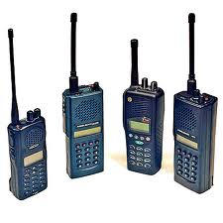
Antennas on handheld radios
Rubber duck
T9A04 The typical “rubber duck antenna
Does not receive or transmit as well
as a full size ground-plane antenna
T9A07 When transmitting from
inside of a vehicle, Signals might not propagate well due to the shielding effect of the vehicle

Slide 40
Decibel, The unit measure for gain
dB = 10 log (p0wer ratio)
Just remember that for every double, or half change in power, there is a 3 dB change.
Increase or decrease depending on the direction of change.
(I rely on my finger calculator.)
Example 1. What is the approximate amount of change in dB of a power increase
from 5 watts to 10 watts? T5B09
3 db
Example 2. What is the approximate amount of change in dB, from a power
decrease from 12 watts to 3 watts? T5B10
6 dB
Example 3. What is the approximate amount of change in dB, of a power increase
from 20 watts to 200 watts? T5B11
10 dB

Slide 41
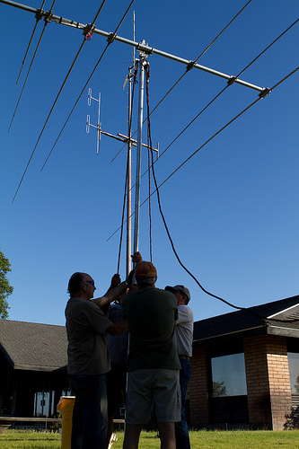
Directional Antennas
T9A01 A Beam Antenna, or Yagi, is an antenna that
directs the signal in one direction.
T3A03 Horizontal directional antennas are
Normally used for weak signal CW and SSB
on VHF and UHF
At the higher UHF frequencies, dish antennas are commonly used.

Slide 42
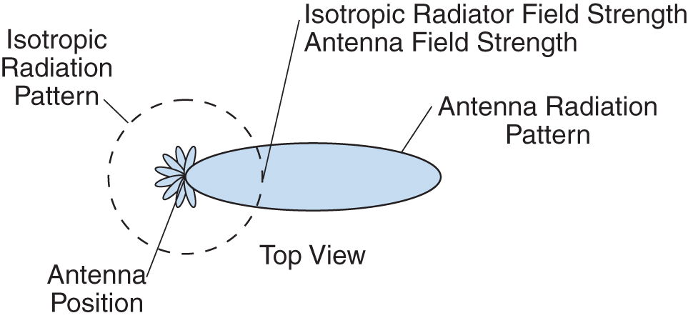
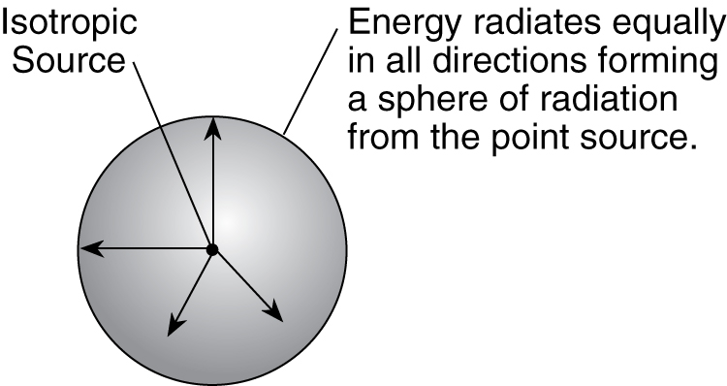
Gain
T9A11 The gain of an antenna is the increase in signal strength in a specified direction when compared to a reference antenna.
Measured in dB
Isotropic Radiator Pattern
“Gain” of an antenna
dBi = gain reference to an isotropic antenna
dBd = gain reference to a dipole antenna
42

Slide 43
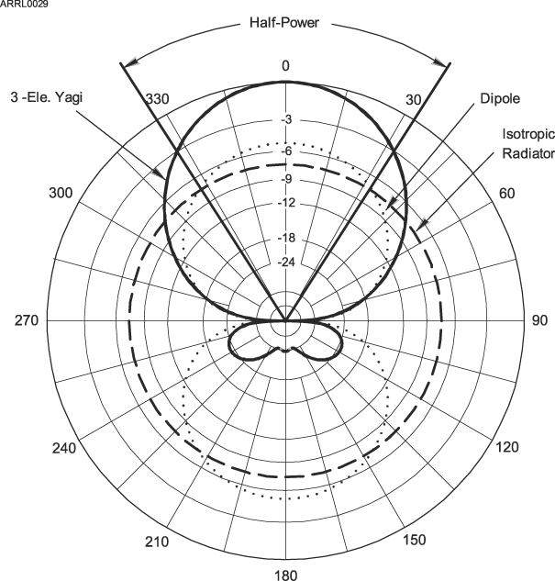
Radiation Pattern
Azimuth pattern

Slide 44
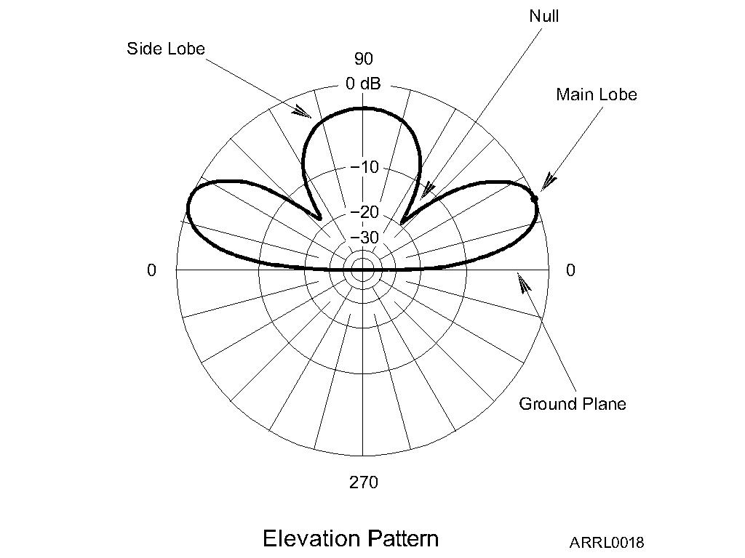
Radiation Pattern

Slide 45
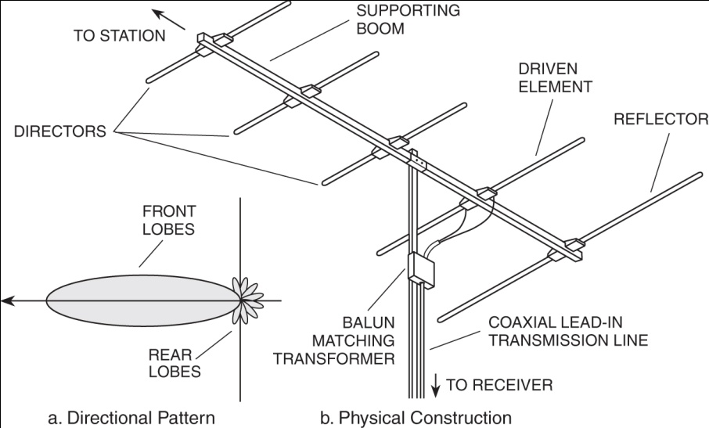
Directional antennas
T9A01 A beam antenna concentrates signals in one direction
A Beam Antenna – The Yagi Antenna
45

Slide 46
Directional antennas
Quad, Yagi and Dish antennas

Slide 48
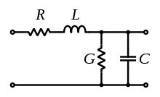
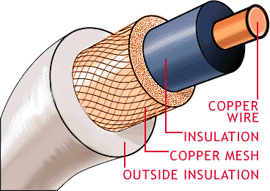
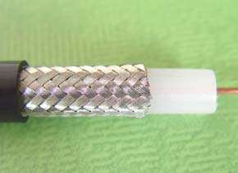
Feedlines
T9B01 It is important to have a low SWR in an antenna system that uses coaxial cable feedline to provide efficient transfer of power and reduce losses.
T9B02 50 ohms is the impedance of the most commonly used coaxial cable in typical amateur radio installations.
T9B03 Coaxial cable is used more often than any other feedline for amateur radio antenna systems because it is easy to use and requires few special installation considerations.
Copper Wire
Outside Insulation
Mesh
48
Insulation

Slide 49
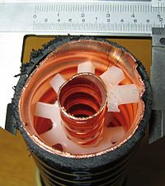
Not all coax is the same
T9B10 Electrical differences exists between the smaller RG-58 and larger RG-8 coaxial cables in that RG-8 cable has less loss at a given frequency.
Coax Cable Type, Size, and Loss per 100 feet
Coax Type Size @ 100 MHz @ 400 MHz
RG-58U Small 4.3 dB 9.4 dB
RG-8X Medium 3.7 dB 8.0 dB
RG-8U Large 1.9 dB 4.1 dB
RG-213 Large 1.9 dB 4.5 dB
Hardline Large, Rigid 0.5 dB 1.5 dB
T9B11 The lowest loss feedline at VHF and UHF is an Air-insulated hard line..
49

Slide 50
SWR Standing Wave Ratio
SWR is determined by the proportions of forward and reflected power.
T7C03 A measure of how well a load is matched to a transmission line
If there is no reflected power, the SWR is 1 to 1. SWR = 1:1
T7C04 SWR of 1:1 is a perfect match.
T7C06 SWR of 4:1 shows impedance mismatch.
T7C05 SWR greater than 2:1 may cause the transmitter’s protective circuits to reduce output power to protect output transistors
T7C07 Power lost in a feedline is converted to heat.
T7C08 Besides a SWR meter, a directional wattmeter can be used to determine match

Slide 51
What causes SWR?
Antennas that are too short or too long.
Faulty feed line or connectors.
T9B09 Erratic SWR sometimes indicates a loose connector.
√P_{F} + √P_{R}
SWR =
P_{F} is the forward RF power
P_{R} is the reflected RF power
√P_{F} - √P_{R}

Slide 52
Checking SWR?
SWR is determined by the proportions of forward and reflected power.
Transmitter
SWR Meter
Or Reflective wattmeter
In series with the feed line, between the transmitter and antenna T4A05

Slide 53
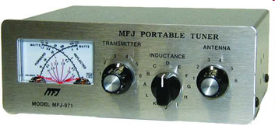
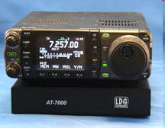
How to Correct High SWR
#1 Correct any physical problems
T9B04 An antenna tuner matches the antenna system impedance to the transceiver's output impedance.
MFJ-971 Portable QRP 200 Watt Tuner
Icom 7000 with LDG 7000 Auto-Tuner
Miracle QPak 50 Watt Manual Tuner
Palstar 1500 Watt Auto-Tuner
MFJ-994B 1500 Watt Auto-Tuner
53

Slide 54
Feedline Connectors
T9B05 As the frequency of a signal passing through coaxial cable is increased the loss increases.
The Higher the frequency the greater the loss
T9B06 A Type N connector is most suitable for frequencies above 400 MHz?
T9B07 PL-259 type coax connectors are commonly used at HF frequencies.
54
BNC, Type N, and PL 259 Connectors

Slide 55
Care and feeding of coax and connectors.
T9B08 Coax connectors exposed to the weather should be sealed against water intrusion to prevent an increase in feedline loss.
T7C09, T9C10, T7C11 Moisture is a common cause of coax failure
Never buy cheap coax, connectors, or adapters
Don’t kink, crush, twist, crimp, mangle, contort, distort or otherwise fubar your coax.
Make sure all coax connections are tight to help minimize interference

Slide 56
Study for this Week
Study flash cards www.hamexam.org
Radio
Fundamentals
Rules &
Regs.
Comm. w/
Others
Antennas
Propagation
Equipment
Electricity
Safety
Lesson 1
T1B
T3B
T8A
Lesson 2
T1A
T1C
TID
T1E
T1F
Lesson 3
T2A
T2B
T2C
T8B
T8C
Lesson 4
T3A
T3C
T9A
T9B
T7C
Lesson 5
T4A
T4B
T7A
T7B
T8D
Lesson 6
T5A
T5B
T5C
T5D
T6A
T6B
T6C
T6D
T7D
Lesson 7
T0A
T0B
T0C
73
Tom and Jack

